Slide 1
Unit 3 Days 1-5

Slide 2
Day 1

Slide 3
Bell Ringer
Why is it important to be smart? How do people treat those who are not seen as “smart”?
Grab a book and read when you are done.

Slide 4
Plan for the Day
Intro to Unit 3
“Two Kinds of Intelligence”
Intro to “Flowers for Algernon”

Slide 5
Essential Questions
What does it mean to be intelligent?
How does a person acquire knowledge? Intelligence? Is there a difference between the two?
How does one’s intelligence affect one’s human experience?
What happens when people are greedy for knowledge?

Slide 6
Texts and Projects
“Flowers for Algernon” by Daniel Keyes
Argumentative Speech
You have to convince your audience to believe what you believe.
Based on science and morality (Ex: Is human cloning right?)

Slide 7
To introduce the topic of “intelligence”…
We are going to do “Would you Rather?”
Some questions relate to our unit, some do not.

Slide 8
Would you rather...
Go into the past and meet your ancestors?
Go into the future and meet your great-great grandchildren?

Slide 9
Would you rather...
Have a rewind button on your life?
Have a pause button on your life?

Slide 10
Would you rather...
Be able to speak to animals?
Be able to speak all foreign languages?

Slide 11
Would you rather...
Be able to read minds?
Be able to tell the future?

Slide 12
Would you rather...
Not have elbows?
Not have knees?

Slide 13
Would you rather...
Be smart?
Be funny?

Slide 14
Would you rather...
Be smart, but know that people hate you?
Be dumb, but not know that people hate you?

Slide 15
Would you rather...
Be physically fit/strong?
Be smart?

Slide 16
Would you rather...
Be good looking?
Be smart?

Slide 17
Would you rather...
Be smart, but know that people hate you?
Be dumb, but not know that people hate you?

Slide 18
Would you rather...
Know everything for 5 years, but then you die?
Have a below average intelligence, and live for a normal amount?

Slide 19
Rumi’s “Two Kinds of Intelligence”
1. Tape the poem into your notebook.
2. Annotate the poem.
3. Describe the two types of intelligence. Which one is more common or thought of?
4. Which type of intelligence do you think is the most important?
5. Make some connections to something outside of the text. What does this poem remind you of?

Slide 20
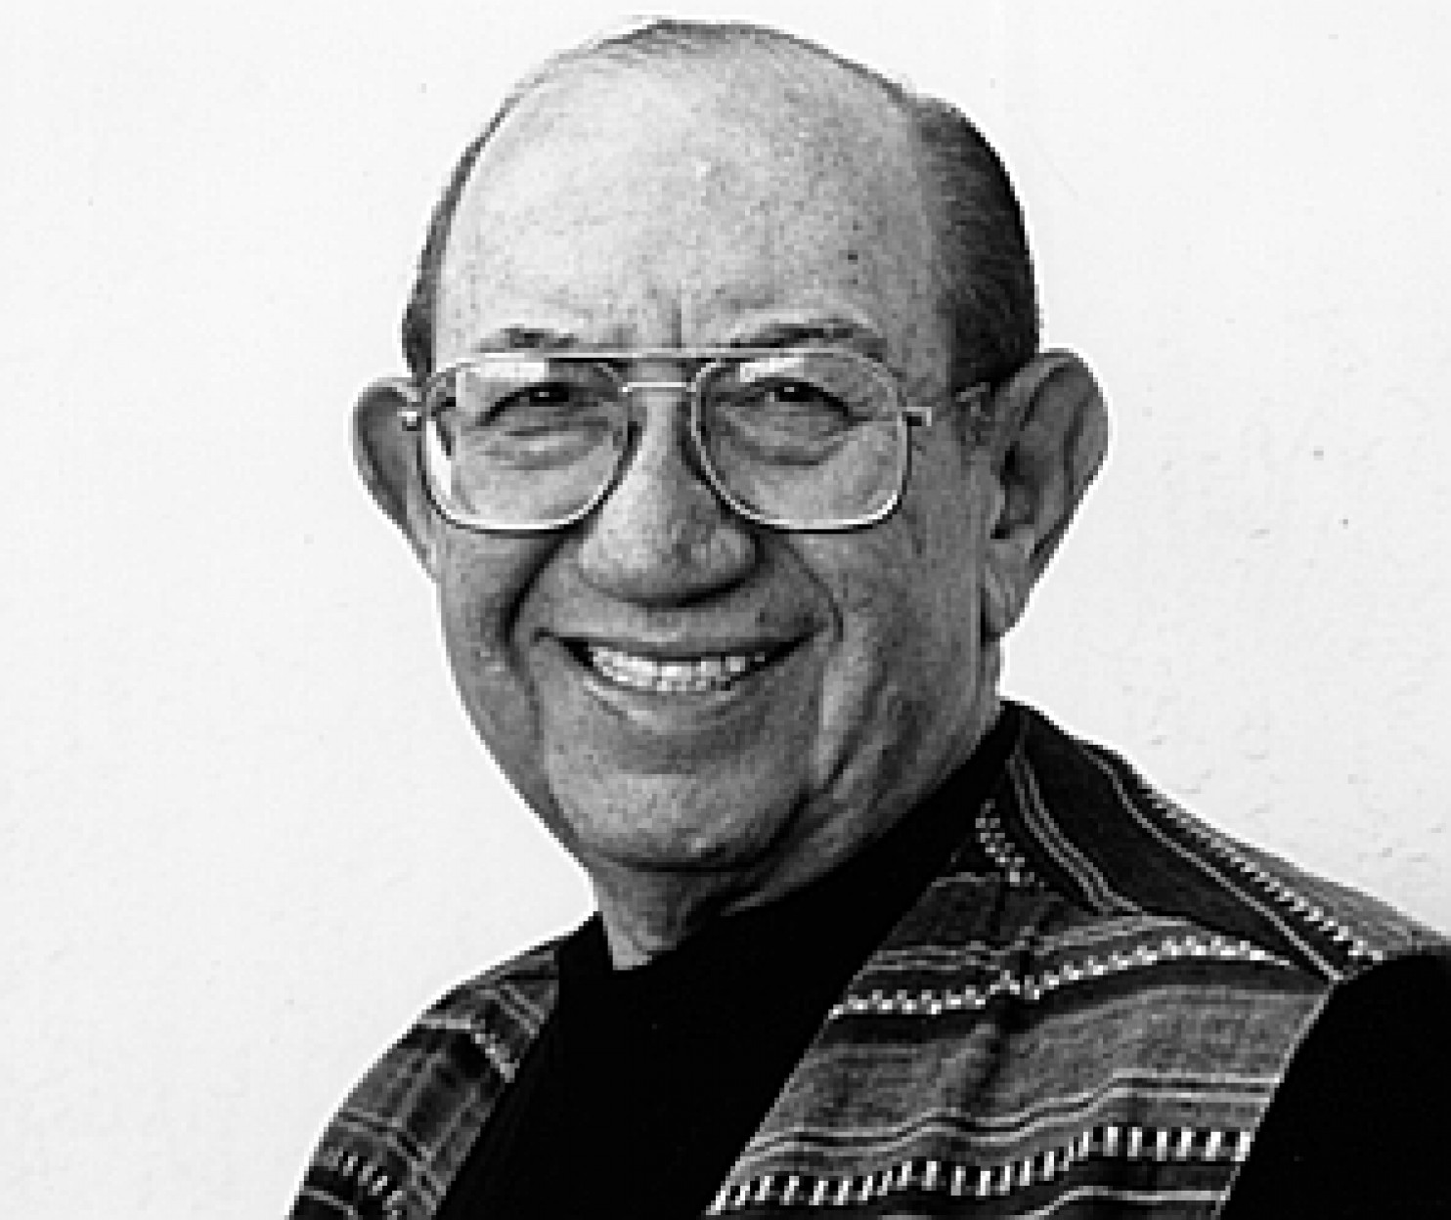
Daniel Keyes
Has a degree in Psychology, but went back to school to get his teaching license.
Taught English in NY, but continued writing on weekends.
Eventually became a college professor.
He’s a pretty smart dude.

Slide 21
“Flowers for Algernon” Background
Written in 1958, published a year later
Originally a short story, but was adapted into a novel in 1966.
It has NEVER gone “out of print” and has multiple awards.

Slide 22
Censorship and “FFA”
It has been “challenged” all over the US and Canada because it is “inappropriate” for young readers (but we’re ignoring that)
Schools in Pennsylvania and Texas succeeded in getting the book removed from school libraries.
It is #4 on the American Library Association’s list of 100 Most Frequently Challenged Books of 1990-1999

Slide 23
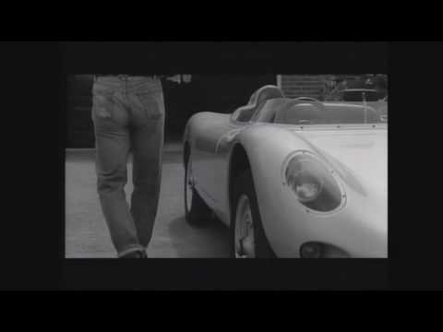
“Dear Algernon” by Kyosuke Hirumo

Slide 24
“Dear Algernon” Lyrics
https://www.paroles-musique.com/eng/Kyosuke_Himuro-Dear_Algernon-lyrics,p07629142

Slide 25
Day 2

Slide 26
Bell Ringer
Make a prediction about the story. What do you think is going to happen to Charlie?

Slide 27
Plan for the Day
Continue "FFA" introduction
“Flowers for Algernon” Reports 1-6

Slide 28
FFA Vocabulary (Page 32 and 33)
Word: | Synonym to Match:
Misled | Conceal
Tangible | Supposition
Refute | Deceived
Invariably | Self-examining
Regression | Always
Verified | Real
Obscure | Disprove
Deterioration | Confirmed
Hypothesis | Reversal
Introspective | Worsening

Slide 29
Answers
Misled (C) Deceived
Tangible (F) Real
Refute (G) Disprove
Invariably (E) Always
Regression (I) Reversal
Verified (H) Confirmed
Obscure (A) Conceal
Deterioration (J) Worsening
Hypothesis (B) Supposition
Introspective (D) Self-examining

Slide 30
“Progris riport 1-martch 5 1965” (33)

Slide 31
Re-Write Contest
Re-write the first progress report. The person who identifies and changes the most errors gets a Jolly Rancher.

Slide 32
Rewrite Answer:
Progress Report-March 5, 1965
Dr. Strauss says I should write down what I think and everything that happens to me from now on. I don’t know why, but he says it’s important so they will see if they will use me. Miss Kinnian says maybe they can make me smart. I want to be smart. My name is Charlie Gordon. I am 37 years old, and 2 weeks ago was my birthday. I have nothing more to write now, so I will close for today.

Slide 33
Let's Read!
"Flowers for Algernon” Reports 1-6 (33)

Slide 34
Day 3

Slide 35
Bell Ringer
What are you doing for the outdoor field trip? If you don't know, what would you LIKE to do?
When you are done, get out your IR book and read.
Please have your IR journal and AOW out on your desk.

Slide 36
Plan for the Day
Finish Reports 1-6
AOW Discussion
Maze Race
Re-write contest

Slide 37
AOW Discussion
Identify the main idea of the article. (Summarize the article in one sentence).
Share your answers to the opinion chart. Then decide who you agree with. Why do you agree with that person?
Copy down a t-chart into your note sheet. Then create a list of "pros" and "cons" of cloning. Use textual evidence to support your answers.
Which of the opinions is the most biased?
Note: bias means an unfair judgement in favor or against something
Example: "My mom says I'm pretty!"

Slide 38
Finish Reports 1-6

Slide 39
Maze Race

Slide 40
Re-Write Contest
Re-write the first progress report. The person who identifies and changes the most errors gets a Jolly Rancher.

Slide 41
Rewrite Answer:
Progress Report-March 5, 1965
Dr. Strauss says I should write down what I think and everything that happens to me from now on. I don’t know why, but he says it’s important so they will see if they will use me. Miss Kinnian says maybe they can make me smart. I want to be smart. My name is Charlie Gordon. I am 37 years old, and 2 weeks ago was my birthday. I have nothing more to write now, so I will close for today.

Slide 42
Day 4

Slide 43
Plan for the Day
Plot Notes
Reports 7-9

Slide 44
Bell Ringer
Why do you think the book is called "Flowers for Algernon"? Make a prediction about the book based on the title.
When you are done, get out your IR book and read.

Slide 45
Due Wednesday: Journal

Slide 46
Plot Notes Continued

Slide 47
Plot and Subplots
Plot: the events of a story.
Subplots: a plot that is related to but less important than the main plot of a story.

Slide 48
Subplot Examples
Subplots are a part of almost every TV show ever.
Think about shows like “Friends,” “Bob’s Burgers,” and “Parks and Rec.”

Slide 49
Parallel Episodes
Two lines of plot that are woven together with a common character or theme.

Slide 50
Reports 7-9

Slide 51
In your notes...
Create a Venn Diagram with two circles. Then Compare/Contrast the two drinking episodes with Joe and Frank.
Drinking Episode 1: (40-41)
Drinking Episode 2: (42-44)
You may work with a partner for this activity.

Slide 52
Get your life together!
With the remaining time, turn in any missing work, re-do assignments, work on your IR project, or do homework for another class.

Slide 53
Day 5

Slide 54
Bell Ringer
What are the important objects in “Flowers for Algernon”? List at least 4. (Hint: You are looking for potential symbols).
When you are done, get out your book to read for a few minutes. While you do that, I will pass back your tests.
YOU WILL NOT BE ALLOWED TO GO TO YOUR LOCKER TO GET YOUR BOOK AFTER THE BELL RINGS.

Slide 55
Plan for the Day
Your tests
Symbolism review
If we have time…
Review parallel episodes
Finish reading "Report 9"

Slide 56
Your Tests
Most of you rocked most of the sections!
Symbolism, however, was a little rough.

Slide 57
Symbolism Review
Turn and talk to the person next to you.
What is the definition of symbolism?
Why is it important to understand symbolism? (Think about "Flowers for Algernon")

Slide 58
1. Draw the important objects in The Outsiders
Mini Gallery Walk: Take a look at what other people drew. If you see a great idea, steal it!
(It’s not plagiarism, don’t freak out).

Slide 59
2. How do the characters feel/react to the object?
Example: Bob’s Rings
Johnny is afraid of Bob’s rings.
Johnny is marked by Bob’s rings.
Bob uses Bob’s rings to show power.
Try it! Pick one of your objects and write three sentences about it.

Slide 60
3. Replace the object with an idea.
Think of this step like checking your answer in math. The sentences are the formula, and the object and idea are the variable.
Example: Bob’s Rings
Johnny is afraid of ______________.
Johnny is marked by ______________.
Bob uses ______________ to show power.

Slide 61
Use this chart to help you with the next activity:
A: _____________ Object: Idea: | B: _____________ Object: Idea: | C: _____________ Object: Idea:
Reflection: What did you think of this activity? What was challenging? How did the conversation go?

Slide 62
Share your answers…
You will be in a group of three. Elect one person to go first.
Person A will share their symbol for one minute.
People B and C will EACH have 30 seconds to respond.
Person A will have 30 more seconds to either respond to what other people said, defend their answer, or add something to their original answer.
IF IT IS NOT YOUR TURN TO SPEAK, YOU MAY NOT TALK. IF YOU RUN OUT OF THINGS TO SAY, YOU MUST WAIT FOR THE TIMER TO GO OFF BEFORE MOVING ON.

Slide 63
Zander, Lacey, Fly Boy
Nate, Izaya, Ryley, Noah
Jenna, Laura, Chris
Marlee, Alissa, Anas
Anna, Ali, Lexi
Nolan, Koi, Kya
Alec, Nya, Brynn
Melby, Aidan, Payton
Parker, Joab, Taylor
Landon, Elijah, Hunter

Slide 64
Exit Ticket
Pick another object and repeat the same steps to identify the meaning of a symbol. Do this on the back of your discussion chart.
BE SURE TO SHOW ALL YOUR WORK!
#mathglish #hashtag
Draw the important objects in The Outsiders
How do the characters feel/react to the object?
Replace the object with an idea.

Slide 65
Symbolism in “FFA”
While we read this next section of “FFA,” pay attention to the important objects.

Slide 66
Finish "Report 9" (40-top of 44)

Slide 67
Parallel Episodes Review

Slide 68
Identifying and Comparing Parallel Episodes

