Slide 1
Unit 1 Days 1-5

Slide 2
Day 1

Slide 3
Welcome to English 8!
Please find a seat. You may sit wherever you would like (for the time being).

Slide 4
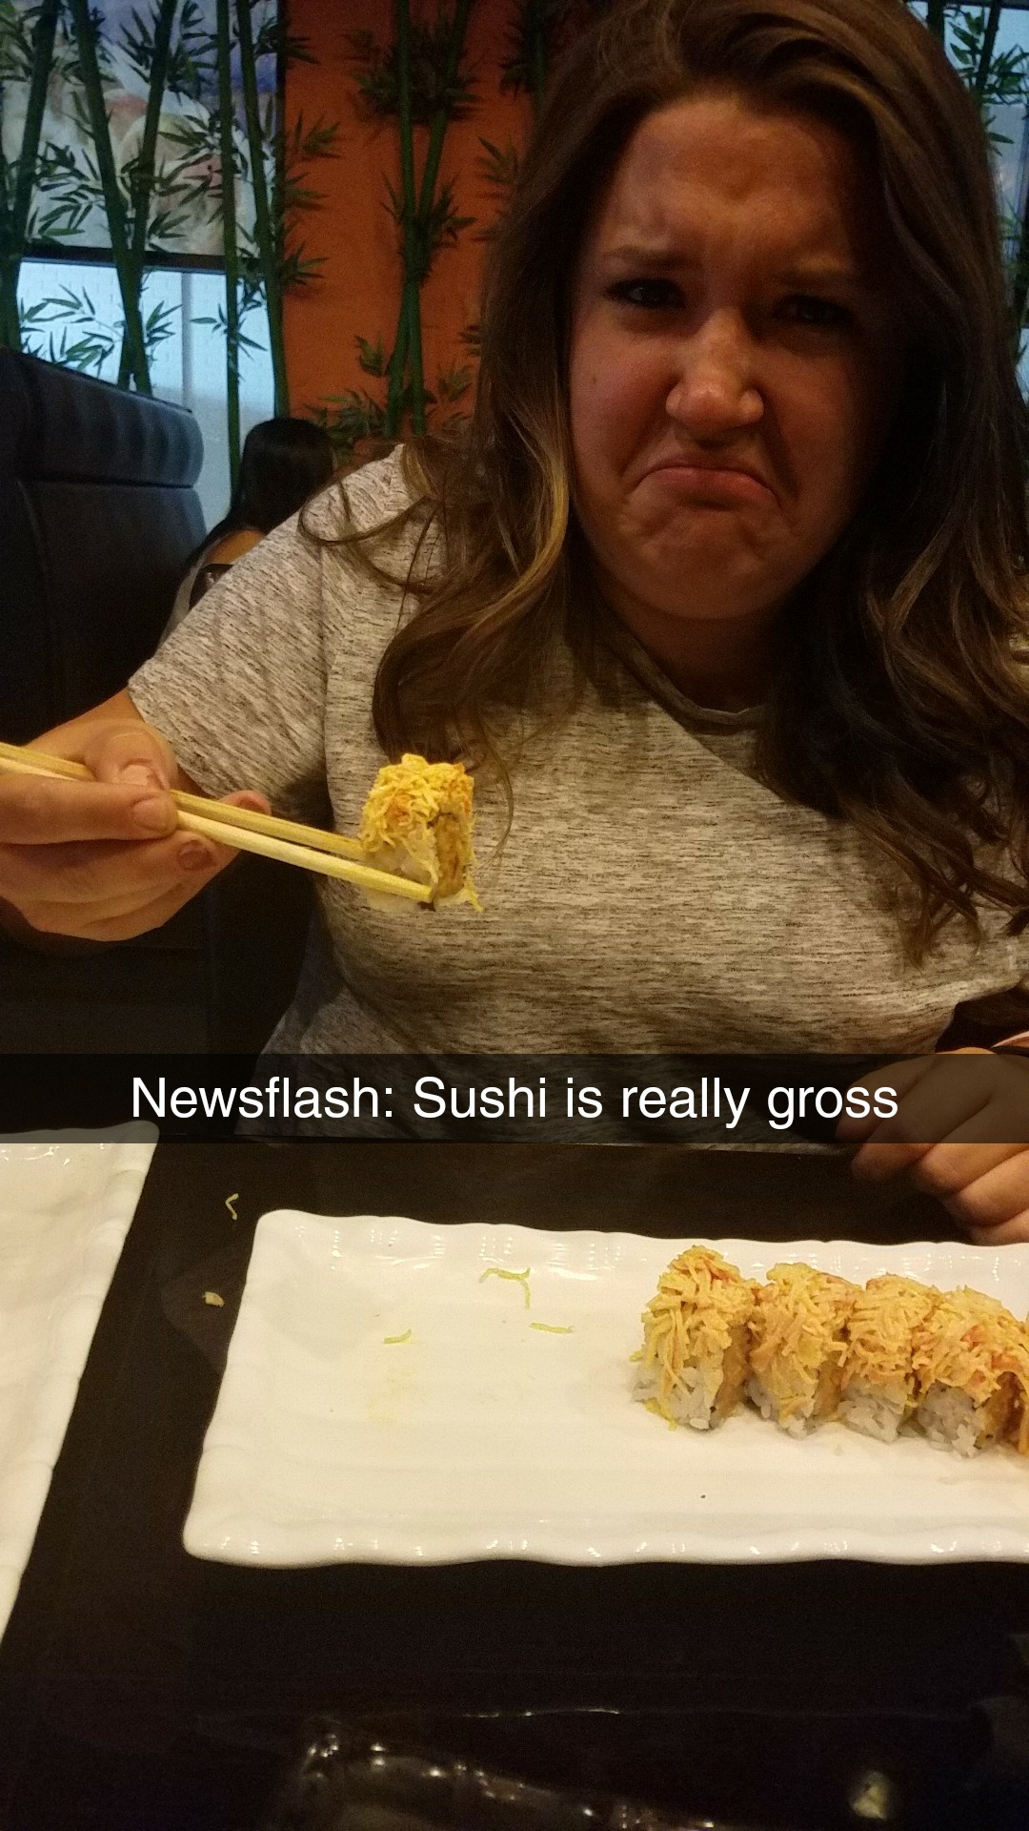
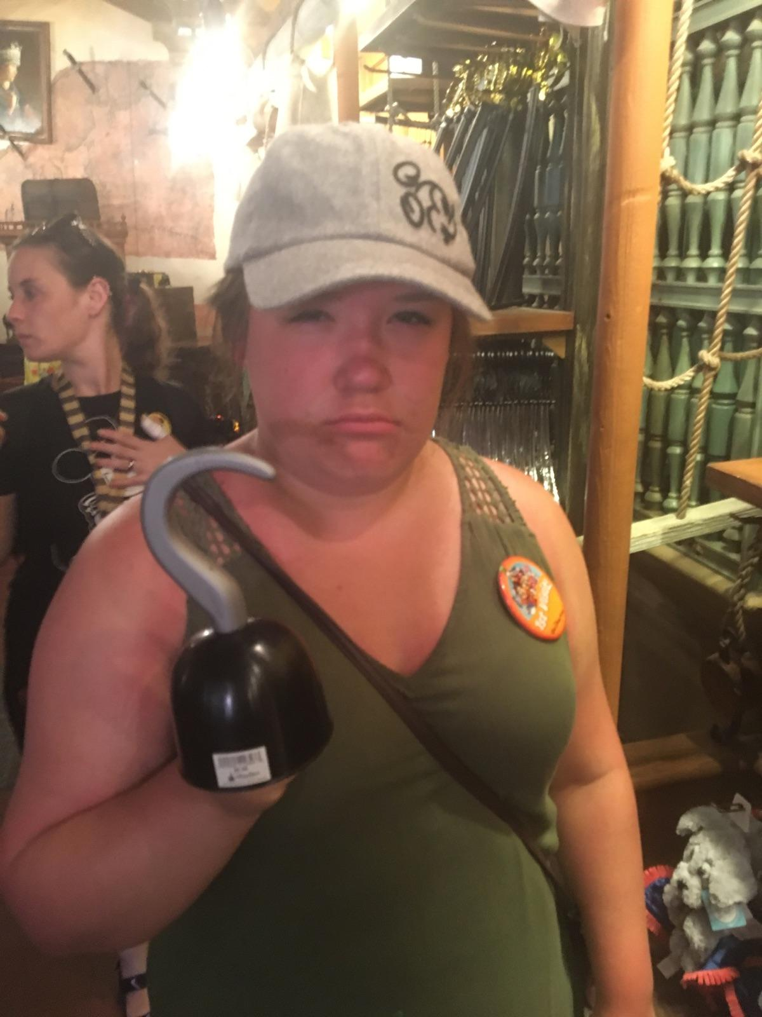
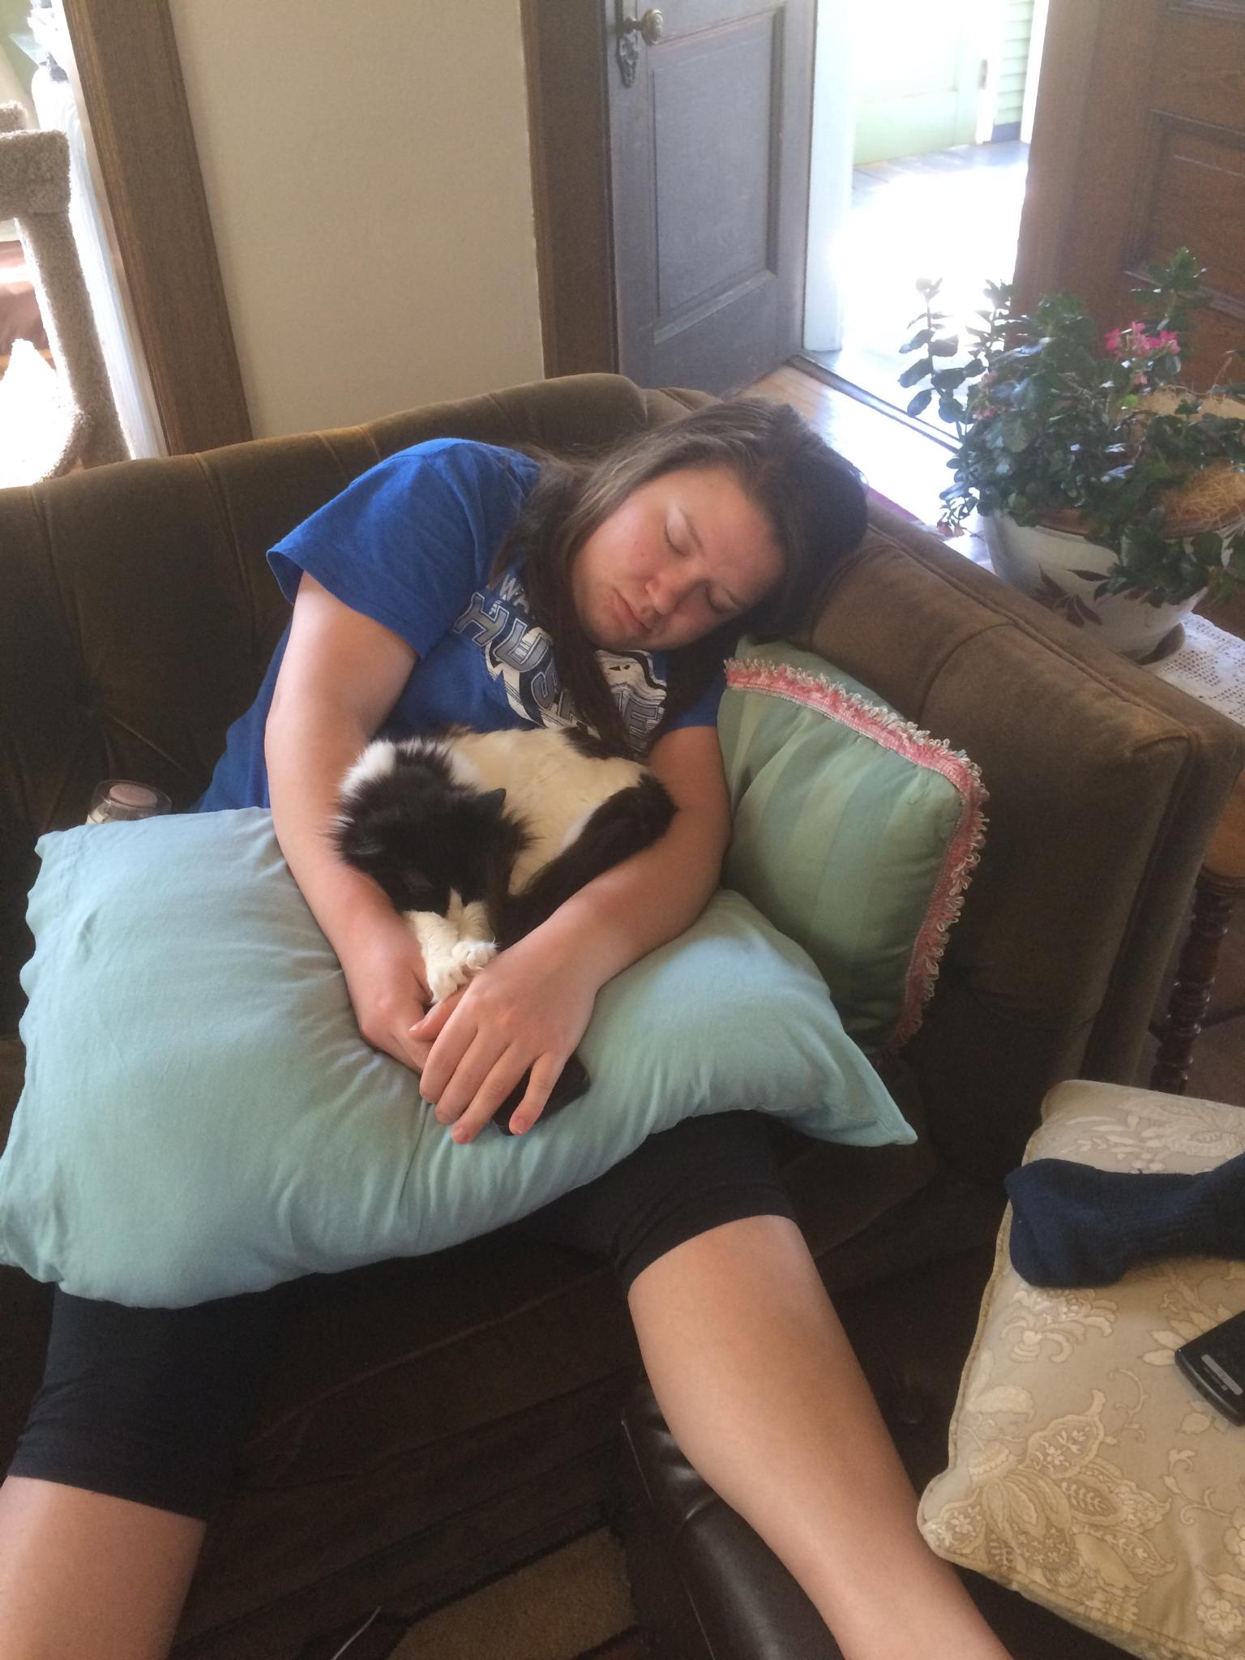
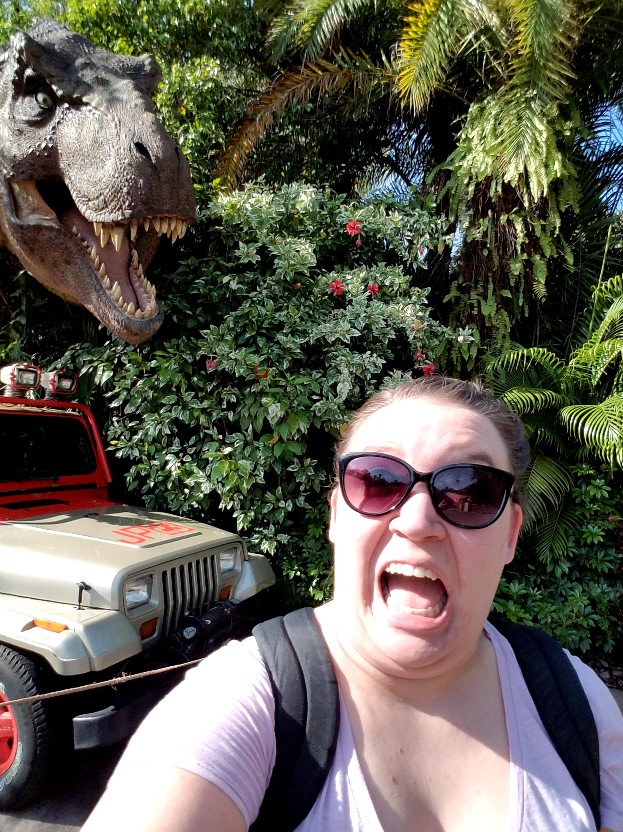
Hi, I’m Ms. Charlton!

Slide 5
Seating Charts

Slide 6
Bell Ringer 9/7/17 or 9/8/17
Describe your summer in 3 words.

Slide 7
This year we will…
And also learn how to write descriptively (without using phrases like “bunch of stuff.”
Read a bunch of stuff
The Outsiders
“Flowers for Algernon”
“The Diary of Anne Frank”
Write a bunch of stuff
Research Paper
Theme Essay
Personal Narrative
Learn how to communicate about a bunch of stuff
Argumentative Speech

Slide 8
Syllabus and General Enrichment

Slide 9
Specific “Enrichment”
Unit 1 (Review)
Quizzes are more difficult.
Unit 2 (The Outsiders)
Added book: Breaking Night
Unit 3 (“Flowers for Algernon”)
Added book: Frankenstein
Unit 4 (“The Diary of Anne Frank”)
Added book: They Poured Fire on us from the Sky
Unit 5 (Dystopian Literature Choice Novel)
Larger final project (TBD)

Slide 10
Brain Break: Switch Sides If…

Slide 11
You prefer dogs over cats.

Slide 12
You live in the country/on a farm.

Slide 13
You speak another language fluently.

Slide 14
You have never read the Harry Potter books AND you have never seen the movies.

Slide 15
You play an instrument.

Slide 16
You have 4 or more siblings.

Slide 17
Have gone surfing.

Slide 18
Broken a bone.

Slide 19
Been trapped in an elevator.

Slide 20
Housekeeping (Just to get us started)
Bathroom policy
Cell phone policy
Cafeteria expectations reminder
Classroom tour

Slide 21
Mini Lesson: Inferences
Inference: reaching a conclusion based on facts or evidence
Example:
A person walks by their dog who is whimpering and sitting by her food dish.
Conclusion:
The dog is hungry.

Slide 22
Inference Practice 1

Slide 23
Inference Practice 2

Slide 24
Inference Practice 3

Slide 25
To practice inferences & to get to know me…
You are going to work with a small group to ask me ONE question. After that, you will work with your group to take a quiz about me.
You can use my answers to all the questions and anything you observe about me and my classroom to answer the questions.
The group with the most questions correct will get Jolly Ranchers.

Slide 26
Raise your hand if you had me last year.

Slide 27
Letter to Ms. Charlton
In a letter to me, answer the following prompts.
Tell me about yourself! What is your family like? Have you always lived in Owatonna? Do you have pets? What are your favorite things? What hobbies do you have? What do you like to do for fun?
Do you like school? Why or why not? What is your favorite class? Why? (Be honest!)
What else do you want to tell me about yourself?

Slide 28
Student Interest Survey
After you are done with your letter, please place it in the basket.
Then grab a yellow survey and answer the questions.
MAKE SURE YOUR NAME IS ON BOTH THE LETTER AND THE SURVEY.
Please be honest! If you hate reading, tell me so I can fix that!

Slide 29
Your Homework (LOL sorry…not sorry)
Read the syllabus with an adult in your life and sign the syllabus agreement
Finish your “Letter to Charlton” and the yellow survey (if you have not already)

Slide 30
Before you go…
We have to take a first day of school selfie!

Slide 31
Day 2

Slide 32
Bell Ringer
How much technology do you use?
Tally the number of social media accounts you have.
Some Options:
Snapchat
Facebook
Instagram
Pinterest
Twitter

Slide 33
Plan for the Day
Pass in homework
Syllabus
Group Story
Not-Lame Bingo
Digital Footprint Activity

Slide 34
Homework
Please take out your letter to me and your yellow survey.

Slide 35
Syllabus (Signed for the next class)
Grading policy
Late assignments
Food
Supplies

Slide 36
Group Story
With a small group you are going to write a short story. One person in your group needs to get out a piece of paper and a pen/pencil.
Once I change the slide, you are going to write a story about the image. HOWEVER, each person is only allowed to write ONE sentence and there can be NO TALKING.
You have 15 minutes.

Slide 38
Not-Lame Bingo
Just in case you don’t know everyone in class, we are going to play a getting to know you game.
YES, I understand that getting to know you games are the WORST, but they are also important…and this one isn’t lame.
“Find Someone Who…” Bingo

Slide 39
Unit 1, Part 1: Digital Citizenship
How not to be a doofus on the internet
Office 365 and MLA format
Plagiarism and Copyright

Slide 40
Digital Footprints
With your table, discuss what a "digital footprint" might be.

Slide 41
Why do we have to do this?
https://vimeo.com/193083648

Slide 42
Real Stories
My friend, a grad student
My cousin’s friend, a freshman in high school
This is not supposed to scare you away from the internet. It’s supposed to get you thinking about how you use it.

Slide 43
Table Discussion
Discuss the following questions and take notes on what you talk about on a sheet of paper that you will turn in at the end of class:
Is the internet optional?
Can we control everything that is posted about us on the internet? Why or why not?

Slide 44
Ms. Charlton on Google and Facebook

Slide 45
Finding your Footprint
Work with your table to look for your “digital footprint.”
Look at Google and Google Images to see what you can find.
When you are done searching, discuss and take notes on the following questions:
What did you find? Is there anything that surprised you? If so, what surprised you?

Slide 46
Final Discussion
Why is it important to know what is on the internet about you?

Slide 48
Day 3

Slide 49
Bell Ringer
What was your biggest "take away" from the digital footprint activity? What did you learn? How will you change the way you use social media? (Or maybe you won't...tell me that too!)
Explain your thoughts in 3-5 sentences.

Slide 50
Plan for the Day
Wrap Up Digital Footprint Activity
Binders
Plagiarism

Slide 51
IR Project Update
You will not have a formal IR project until the library is set up and ready to go.
HOWEVER, we are still going to be reading in class. You will need your first book for the next class.
If you want to borrow one of mine, that is fine, but you may NOT take it out of the room.

Slide 52
Binders
You will use these binders for each of your "core" classes (English, Social Studies, Math, and Science.)
You will need 4 tabs (one for each class.)

Slide 53
Plagiarism
Definition: Taking someone else's work and passing it off as your own.

Slide 55
Brain Break: Moo Off (#thanksNaven)
Note: If you have a great idea for a brain break, let me know!

Slide 56
Intentional Plagiarism
Definition: Taking someone else's work ON PURPOSE.
Examples:
Looking at someone else's paper and copying the answer.
Buying an essay from the internet.
Paying someone else to do your work.

Slide 57
Accidental Plagiarism
Definition: still plagiarism, but it is not done on purpose.
Examples:
Not giving credit to the original author.
Not putting quotes in quotation marks.
Poor paraphrasing.

Slide 58
Consequences of Plagiarism
In my class...
You get a 0 on the assignment.
You are not allowed to re-do the assignment.
In college...
You fail the entire class.
You could get kicked out of school.
You could get fined.
In a job...
You could get fired.

Slide 60
How to Avoid Plagiarism
Cite all your sources (author's name MINIMUM)
Put direct quotes into quotation marks.

Slide 61
Is it Plagiarism?
On each side of the room is a sign that says "Plagiarism" or "Not Plagiarism."
For each statement, move to the side of the room that you think is correct.

Slide 62
I paid someone else to do my homework for me. I paid them, so it's ok.

Slide 63
I wrote a short story based on my life. I didn't cite my sources.

Slide 64
I used an online sample to help me with my math homework.

Slide 65
I found a research paper online that has the same topic as mine! I modeled my own paper after that one.

Slide 66
I used someone else's words, but I put them inside quotation marks like this:
"Ms. Charlton is SO pretty, smart, and funny. She really is the best teacher ever."

Slide 67
BASICALLY…
If you are going to use someone else’s words, GIVE THEM CREDIT.
We will talk about citations tomorrow.
ALSO:
YOU NEED TO BRING A BOOK TO THE NEXT CLASS.

Slide 68
Not-Lame Bingo
Just in case you don’t know everyone in class, we are going to play a getting to know you game.
YES, I understand that getting to know you games are the WORST, but they are also important…and this one isn’t lame.
“Find Someone Who…” Bingo

Slide 69
Day 4

Slide 70
Bell Ringer
Why do you think the consequences of plagiarism are so severe?
Answer the prompt in 3-5 sentences.

Slide 71
Plan for the Day
Pre-Assessment
Reading Time

Slide 72
Pre-Assessment

Slide 73
Day 5

Slide 74
Bell Ringer
How do you think the pre-assessment went? Did you feel comfortable answering all of the questions? Which ones were difficult for you?

Slide 75
Plan for the Day
Finish Pre-assessment
Copyright and Public Domain

Slide 76
Finish Pre-Assessment

Slide 77
Public Domain
Creative work that is NOT copyrighted and is free to use however you want.

Slide 78
Fair Use
Fair use: the ability to use copyrighted work without permission, but only in certain ways and in specific situations.

Slide 79
Specific Situations:
Schoolwork and education
News reporting
Criticizing or commenting on something
Comedy/parody
Remixing/reworking

Slide 80
Remix/Rework Example

Slide 81
Turn and Talk
How are fair use and public domain different?

Slide 82
Case Studies in Fair Use

Slide 83
Case Study 1: Scary Mary

Slide 84
Case Study 2: DJ Earworm

Slide 85
Case Study 3: Teen Crush (Play 2:45)

Slide 86
Getting around copyright…
Use a small amount
Add new meaning and make it original
Rework it and use it in a different way
Use it for a nonprofit purpose

Slide 87
Taylor Swift and Music Streaming
We are going to practice “marking the text” with the article “Are Musicians going up a Music Stream without a Fair Payout?”

Slide 88
Section 1: Ms. Charlton Marks the Text

Slide 89
Section 2: We Mark the Text

Slide 90
The Rest: You Mark the Text (with a partner)
The rest of the article is your homework. You may use the rest of class to work.

