Slide 1
Unit 1: Days 11-15

Slide 2
Day 11

Slide 3
Bell Ringer
What did you think of “After Twenty Years”?
Answer the prompt in 3-5 sentences. Then read your book.

Slide 4
Class Updates
Reading Time
IR Projects (copies coming to you next class)
Late Assignments

Slide 5
Plot Competition

Slide 6
Reading Strategies: Connections and Vocab.
Connections
This reminds me of…
This relates to my life because…
Vocabulary
Highlight/Squiggle under any word you don’t understand

Slide 7
O. Henry Biography
While we read, highlight/squiggle each word that you don't immediately know the definition of.
Also make note of any connections you make between the biography and "After Twenty Years."

Slide 8
Vocabulary Study

Slide 9
Day 12

Slide 10
Bell Ringer
How would "After Twenty Years" be different if it were set in 2017?
Explain your answer in 3-5 sentences.
Then read your IR book.

Slide 11
Plan for the Day
Free Write
Introduction to questioning

Slide 12
Pass in your O. Henry Biography

Slide 13
Free Write
If you were in Jimmy's position, what would you have done?
Do you think Jimmy did the right thing? Why or why not?

Slide 14
Introduction to Questioning Sort
With your team, sort the questions.
I am not going to tell you HOW you have to sort them. There is no wrong way to do this...the first time.

Slide 15
Costa's Levels Questioning
(An AVID strategy)

Slide 16
Level 1
"Look it up" Questions
Clear answers, usually black and white
If you can ask Siri, it’s a level 1 question.

Slide 17
Level 2
"Read between the lines"
You interpret/infer the answer

Slide 18
Level 3
Open-Ended
No clear answer
Usually opinions

Slide 19
Re-sort the Questions

Slide 20
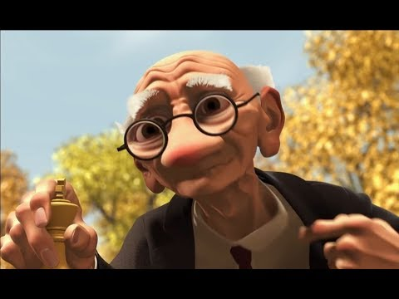
Questioning Practice

Slide 21
“Jerry’s Game”
On a HALF sheet of paper, write one of each level of questions about "Jerry's Game.“
DO NOT WRITE YOUR NAME ON IT.

Slide 22
Evaluating Our Questions
We are going to sort your questions.
With your team, decide if the question read is Level 1, 2, or 3.
Then write your answer on your white board.

Slide 23
Day 13

Slide 24
Bell Ringer
Why is it important to make connections while you read?
Remember, I shouldn’t have to tell you what to do next!

Slide 25
Plan for the Day
Visualizing
Wrap up questioning
"The Circuit" nonfiction preparation

Slide 26
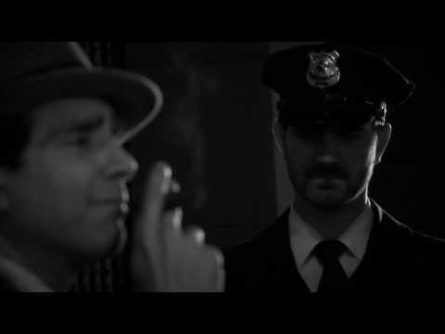
“After Twenty Years” Video

Slide 27
Turn and Talk: Visualizing
How does this video change how you understand or imagine the story?
How is the video different from what you pictured as you read?

Slide 28
Questioning Practice

Slide 29
“Geri’s Game”
On a HALF sheet of paper, write one of each level of questions about "Jerry's Game.“
DO NOT WRITE YOUR NAME ON IT.

Slide 30
Evaluating Our Questions
We are going to sort your questions.
With your team, decide if the question read is Level 1, 2, or 3.
Then write your answer on your white board.

Slide 31
“Cesar Chavez: He Made a Difference”
Textbook (291)

Slide 32
Step 1: Write 5 Questions
Based on the article, write 5 questions.

Slide 33
Step 2: Label someone's questions.
Trade questions with someone who is NOT at your table clump.
Then label their questions Level 1, 2, or 3.

Slide 34
Step 3: Improve someone's questions.
Trade again.
Then bump up each question to the next level. If it is already a level 3, leave it alone.

Slide 35
Step 3: Answer someone's questions.
Trade one more time.
Then use the resources in the classroom to answer the questions.

Slide 36
Day 14

Slide 37
Bell Ringer
Take the following level 1 question and re-write it so it is level 2. Then re-write it as a level 3.
Label the parts of the plot diagram.

Slide 38
Plan for the Day
Continue nonfiction prep
"The Circuit"

Slide 39
Step 3: Improve someone's questions.
Trade again.
Then bump up each question to the next level. If it is already a level 3, leave it alone.

Slide 40
Step 3: Answer someone's questions.
Trade one more time.
Then use the resources in the classroom to answer the questions.

Slide 41
"The Circuit" Mini-Debate
Using your research from the question scramble, and any new research you may need, prepare a for a debate.
Landowners vs. Farmhands
Should farmhands receive better compensation for their work?

Slide 42
NewsELA
https://newsela.com/quickjoin/#/YXESPF

Slide 43
Day 15

Slide 44
Bell Ringer
What are you doing over MEA break?

Slide 45
Plan for the Day
Landowner/Farmhand Debate
Reading Strategies
“The Circuit”

Slide 46
Debate
Red Card: Farm owners
Black Card: Farm workers

Slide 47
Reading Strategies (Speed Notes)
Predict: a guess about the future
Visualize: the movie in your head
Question: Costa's 3 Levels
Connect: how does the reading relate to you, the world, or other texts?
Identify: plot, setting, theme, tone, symbolism, vocab...
Infer: reaching a conclusion based on fact or evidence
Evaluate: deciding what your opinion is

Slide 48
"The Circuit“ (281)

Slide 49
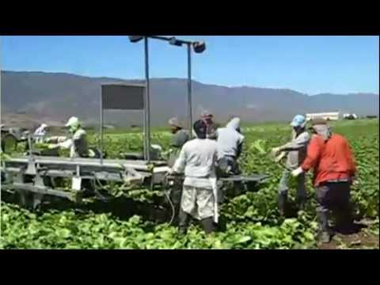
Migrant Camps

Slide 50
"The Circuit" and Plot
Draw a plot diagram on a CLEAN sheet of paper.

Slide 51
"The Circuit" and Costa
On the same sheet of paper as your plot diagram, write 5 questions about "The Circuit." NONE of them should be level 1.

