Slide 1
Unit 2 Days 11-15

Slide 2
Day 11

Slide 3
Bell Ringer 1
What is a “hero”? Can everyone be a hero? Why or why not?

Slide 4
Plan for the Day
Breaking Night reading quiz
Finish Chapter 6
Character Development
Start Chapter 7

Slide 5
Heads Up:
All Outsiders work will be due AFTER break
Unit 2 identity project information coming to you on Friday

Slide 6
Breaking Night Reading Quiz (up to 169)
What sickness does Liz’s mom have?
What is Liz’s sister’s name?
Who does Liz live with after she leaves the group home?
List ONE of the ways Liz earns money.
What do Liz and her sister eat when their parents are high?
Who forces Liz to go to school?
What city does Liz’s family live in?
What did Liz put on her eggs to make them taste better?
Other than her illness, what physical ailment does Ma have?
What does Pa bring Liz from a dumpster?
True or False: Liz is tempted to do drugs.
How do Liz and Sam meet?
What happens when Liz goes back to the apartment with Sam?

Slide 7
Breaking Night Next Section
Liz and her dad get her signed up for school

Slide 8
Finish Chapter 6 (101-107)

Slide 9
Characterization Notes
Tape the following page into your notes. As we go through the slides, fill in the blanks.

Slide 10
Direct Characterization
When the writer/narrator tells you directly what a character is like in a story.
“Scrooge was a selfish, grumpy man.”

Slide 11
Indirect Characterization
The writer makes YOU observe the character by show you their actions, reactions, speech, thoughts/feelings.
Scrooge denies his workers a day off for Christmas and keeps the office freezing cold because he doesn’t want to pay for coal.

Slide 12
Static Characters
A character that remains mostly the same throughout a story.
Example: Bert, a bumbling salesman, never takes the time to organize his files, properly record his sales, or follow up with customers. Finally, his boss gets fed up and fires him. Bert struggles for two months to find a new sales position. During that time, his car is repossessed and he maxes out his credit cards. Bert finally finds a new sales position but, before a week passes, he is called into a conference with his new boss and is informed he must get organized or he’ll be fired. A week later the new boss fires Bert after he fails to follow up with an important customer.

Slide 13
Dynamic Characters
A character who changes during the story. The change is permanent. AKA: Character Development.
Example: Ebenezer Scrooge, in A Christmas Carol by Dickens, was very stingy with his money. He worked his employees very hard for little pay. After his experiences with the ghosts that visited him, he changed his ways, paying his employees a more than fair wage, providing days off work and actually giving gifts.

Slide 14
Character Development Chart
Example: “The Tell-Tale Heart”

Slide 15
Start Chapter 7 (108-118)

Slide 16
Day 12

Slide 17
Bell Ringer 2
Make a concept map that connects The Outsiders to the Ted Talks that we watched before Thanksgiving. What ideas can you connect between the two?

Slide 18
Plan for the Day
Project Info
Chapter 7
Get your life together!
Character analysis
Start Chapter 8

Slide 19
Identity Project Information

Slide 20
Finish Chapter 7 (118-126)

Slide 21
Get your life together!
Top priority: Character Chart
Next priority: Layers of Understanding Chart
Not really a priority: Green packet
While you get your life together, I am going to pass back the millions of papers that I have been hoarding. 🙀🙈😧
(Guess who just found out how to add emojis to the slides! 💁💃🐈)

Slide 22
Character Analysis
Strengths 💪 💯
Weaknesses 📉 🚫
Defining Moment 💣 🎓 ⏰
Relationships to to other characters 👨‍👩‍👧‍👦💑

Slide 23
Start Chapter 8

Slide 24
Day 13

Slide 25
Bell Ringer 3
What do you think Two-Bit meant when he tells Ponyboy, "Ya'll were heroes from the beginning. You just didn't 'turn' all of a sudden" (115). Do you think that's true? Why or why not?

Slide 26
Plan for the Day
Finish Chapter 8
Character analysis wrap up discussion
Questioning Amp Up
Start Movie?

Slide 27
What would you do?
Twice, Liz has had to quickly pack up her belongings and leave – once when Children’s Services came to her house and once when she decides to leave Carlos. Imagine Children’s Services shows up at your front door. You have 10 minutes to pack a backpack to take with you. What would you put in your backpack?
Choose 10 items and explain why you would take those with you (you automatically get 2 pairs of pants, 2 shirts, 2 sets of undergarments, 2 pairs of socks and 1 pair of shoes). All of your items MUST fit in your backpack, so choose wisely!

Slide 28
Finish Chapter 8

Slide 29
Quote Discussion 1
"You know, the only thing that keeps Darry from bein' a Soc is us" (134)

Slide 30
Quote Discussion 2
"'Can you see the sunset real good from the West Side?'
She blinked, startled, then smiled. 'Real good.'
'You can see it good from the East Side, too,' I said quietly" (138).

Slide 31
Questioning Amp Up
Make sure you have at least one question for every chapter.
Switch with a neighbor.
Label your neighbor’s questions as L1, L2, L3.
Switch back so the original person has their paper back.
Bump up each of your questions. L1→L2/L3, L2→L3

Slide 32
Movie
End at 1:24

Slide 33
Day 14

Slide 34
Bell Ringer 4
What are you doing for Husky Pride Day? For Winter Break?
Bring a book to class today! (Preferably a book other than Breaking Night).

Slide 35
Plan for the Day
Reading Time
Movie

Slide 36
Day 15

Slide 37
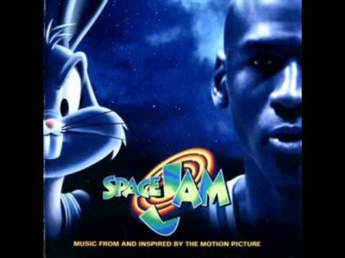
Bell Ringer 5
Welcome back from break!
What are you looking forward to this year? Do you have any New Year's resolutions? If so, what are they?
#NewYearNewSeats

Slide 38
Plan for the Day
Announcements
Chapter 9
Supplemental Text Exploration

Slide 39
Announcements
New Room Arrangement
Due Dates
Rainbow Sheets: January 10th
Unit 2 Test: January 10th
End of Semester (Late/Missing): January 17th
Identity Project: February 5th
Homework: Poetry Analysis (Due next class)

Slide 40
Chapter 9 (139-157)

Slide 41
Discussion
Look at the “Greaser Anthem." How do the greasers define themselves? Do they all fit that description? (144)
Why do the greasers fight? What makes Ponyboy different? (145)
Darry is often talked about as different than the rest, yet he is the leader of the group. How is he different? (146)
What is the difference between greasers and hoods? (146-147, 149)
What do you think Johnny meant when he told Pony to “stay gold”? (157)
Dally's Reaction: What does this say about his character?

Slide 42
Ted Talk | Nonfiction | Poetry | Creative
Write a summary of the article. Create a concept map to make connections between this video and what Murray writes about in the book. Then write and answer 4 level 2 or 3 questions. Each answer should be 3-5 sentences. | Write a nonfiction summary of the article. Then write and answer 5 level 2 or 3 questions. Each answer should be 3-5 sentences. | Pick two of the poems. Then go through the same steps we did with “Nothing Gold Can Stay.” | Write a ONE PAGE article about one of the events of a book we read this unit. Include quotes from interviews and details from the text. After your article, provide quotes from the book to support the details you provided.

Slide 43
Supplemental Text Options
Liz Murray Ted Talk (Youtube)
Harvard Crimson's article (Liz's experience at Harvard)
http://bit.ly/2jV7tkV “After Harvard, a New Home”
Poetry Analysis (Pick two)
"I am Nobody" Emily Dickinson
"Dreams" Langston Hughes
"Those Winter Sundays" Robert Hayden
Newspaper Article
Breaking Night or The Outsiders

Slide 44
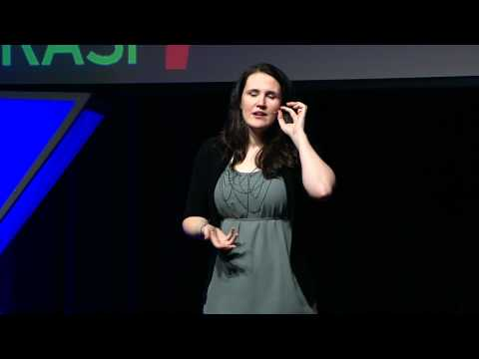
Liz Murray Ted Talk

