Slide 1
Unit 2 Days 16-20

Slide 2
Day 16

Slide 3
Bell Ringer 6
Make a prediction about how the other greasers are going to react to Johnny’s death. Who do you think will have the most dramatic response? Explain your answers.

Slide 4
Plan for the Day
Supplemental Text Exploration work time and presentations
Chapters 10 and 11
Questioning Review

Slide 5
Ted Talk | Nonfiction | Poetry | Creative
Write a summary of the article. Create a concept map to make connections between this video and what Murray writes about in the book. Then write and answer 4 level 2 or 3 questions. Each answer should be 3-5 sentences. | Write a nonfiction summary of the article. Then write and answer 5 level 2 or 3 questions. Each answer should be 3-5 sentences. | Pick two of the poems. Then go through the same steps we did with “Nothing Gold Can Stay.” | Write a ONE PAGE article about one of the events of a book we read this unit. Include quotes from interviews and details from the text. After your article, provide quotes from the book to support the details you provided.

Slide 6
Presentations

Slide 7
Chapter 10 (158-168)

Slide 8
Day 17

Slide 9
Bell Ringer 7
Copy down the following chart. Then make an inference by filling out the boxes.
What the text says…​ | Connections/Schema​
A man ran after a retreating bus, waving his briefcase frantically.​ ​ | ​ ​ ​ ​ ​
My inference…​
​ ​

Slide 10
Plan for the Day
Chapters 10-12
Wrap Up and Review: Symbolism and Inferences

Slide 11
Finish Chapter 10

Slide 12
What do we know about Dally?
Went to jail at the age of 10
Doesn’t care about anyone or anything
Tough
“…you get tough like me and you don’t get hurt. You look out for yourself and nothin’ can touch you…” (159)

Slide 13
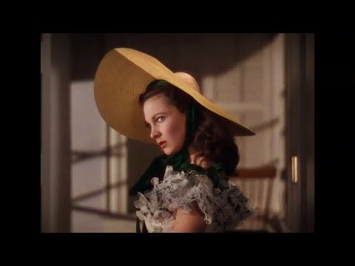
Dally and Gone with the Wind
“’I bet they were cool ol’ guys,’ he said, his eyes glowing, after I read the part about them riding into sure death because they were gallant. ‘They remind me of Dally.’”

Slide 14
Chapter 11 (169-174)

Slide 15
Chapter 12 (175-188)

Slide 16
Day 18

Slide 17
Bell Ringer 8
What did you think of the ending of The Outsiders? Did it end the way you thought it would?
When you are done, turn in your bell ringers. Make sure your name is on it.

Slide 18
Plan for the Day
Finish movie
Review for the test
Symbolism
Inferences

Slide 19
Finish Movie!

Slide 20
Your Test…
Format
Part 1: Inferences
Like yesterday’s bell ringer
Part 2: Characters’ Identity
Short answer, character traits
Part 3: Symbolism
I give you a symbol, you tell me what it means.
Part 4: Reading Comprehension
Multiple choice
Part 5: Literature Analysis
Explain quotes from the book
Part 6: Theme
What to study…
Inferences
Symbolism
Identity Notes
Rainbow Outsiders Work

Slide 21
Inference Review: Copy this into your notebook
Textual Evidence | Connections/Schema
1. 2. 3. 4. 5. | 1. 2. 3. 4. 5.
My inference…

Slide 22
Directions:
Read ONE of the poems. Then fill out the inference chart.
If you had me last year you may NOT do Poem A.

Slide 23
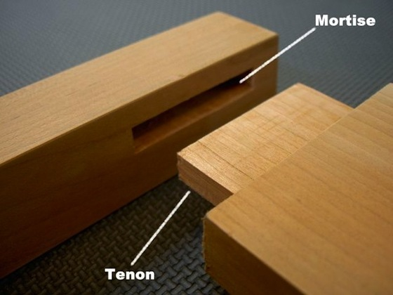
I wear a helmet
On my back.
It’s hard
And guards
Me from attack.
Or if I wheeze,
Or sneeze,
Or cough,
The shell I dwell in
Won’t fall off.
It’s glued without
A screw or mortise. I’m born with it.

Slide 24
When somebody hits me,
A crowd always cheers.
I don't understand it,
But it brings me to tears.
It thrills people silly
To throw me around
And make me go bouncing
Across the hard ground.
I'm battered by bats
Just to make the crowd shout.
I am sick of this game
It's not safe, I want out!

Slide 25
Symbolism Review: Kahoot!

Slide 26
Day 19

Slide 27
Bell Ringer 1
What did you do to prepare for the test? What is your goal score for the test (out of 10 points)?
When you are done, get out your notes to study and your Outsiders work.

Slide 28
Plan for the Day
Unit 2 Test
Reading Time

Slide 29
Pass in your Outsiders Work
Green Packet
Layers of Understanding Chart
Character Chart

Slide 30
Unit 2 Test
Finish the test.
Double check your work.
Make sure your name is on it.
Turn it in to the basket.
Read your IR book.

Slide 31
Day 20

Slide 32
Bell Ringer 2
How do you think the test went? What was the most difficult part? Why?

Slide 33
Plan for the Day
Finish the test
Socratic Seminar Prep

Slide 34
Finish the test

Slide 35
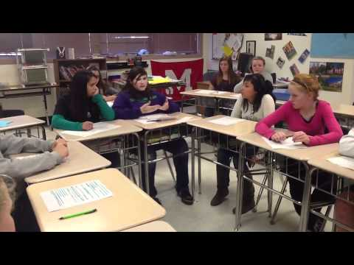
What's a Socratic Seminar?

Slide 36
How will I be graded?
 | Does not Meet Points: 1-5​​ | Needs Work Points: 6​ | Partially Meets ​ Points: 7​ | Meets Points: 8​ | Exceeds Points: 9, 10​​
Questioning​ | I need to clarify my questions so they relate directly to the text.​ | I can ask questions to clarify what the text means.​ | I can pose questions that reference the text.​ | I can pose questions that emerge directly from text evidence and clarify a peer’s contribution.​ | I can use multiple contributions to pose deeper level questions.​
Expressing Ideas​ | I need to participate by using my notes, expressing my own ideas and making my own connections.​ | I can summarize ideas from the text.​ | I can express my ideas clearly with loose connections to the text.​ | I can express my ideas clearly and persuasively using text evidence and summarize points of agreement/disagreement.​ | I can make new connections from evidence and reasoning in the dialogue.​
Generating Ideas​ | I need to listen to others and create my own responses.​ | I can reiterate what someone else said.​ | I can respond to questions in a dialogue.​ | I can use evidence from the texts to generate dialogue and build on other’s ideas.​ | I can pose questions and comments that help the dialogue go deeper.​

Slide 37
Step One: Identifying the Questions
Pick your SIX best questions from your Layers of Understanding Chart for The Outsiders
Write them out on a sheet of notebook paper, leaving at LEAST 4 lines between each question.

Slide 38
Step 2: Answer your Questions
Each of your questions should also have...
The answer, written in bullet points
Quote from the text supporting the answer with a page number
A connection that you can make to your own life (another text, personal experience, something going on in the world)

Slide 39
Step 3: Answer my questions
Around the room there are five different questions.
On the same sheet of paper and in the same format, answer each question.

