Slide 1
Unit 2 Days 21-25

Slide 2
Day 21

Slide 3
Bell Ringer 3
Who is your favorite character from The Outsiders? Why is s/he your favorite?
When you are done with your bell ringer, get out your IR book and read silently. While you do that, I am going to pass back a million papers.

Slide 4
Plan for the Day
Paper pass back party
Continue seminar prep.
The Outsiders Quilt

Slide 5
IR Project Update: Books that are Movies
If you would like to read a book that is a movie, you must…
Read the book (duh).
Watch the movie.
Make a list of SPECIFIC ways the movie is different from the book.
Write a paragraph that compares the book to the movie.

Slide 6
Continue Seminar Prep
Remember, all questions must have…
Bullet point answer
Textual evidence WITH A PAGE NUMBER
Connection to your life, another text, or something going on in the world.
The next class period is the seminar!

Slide 7
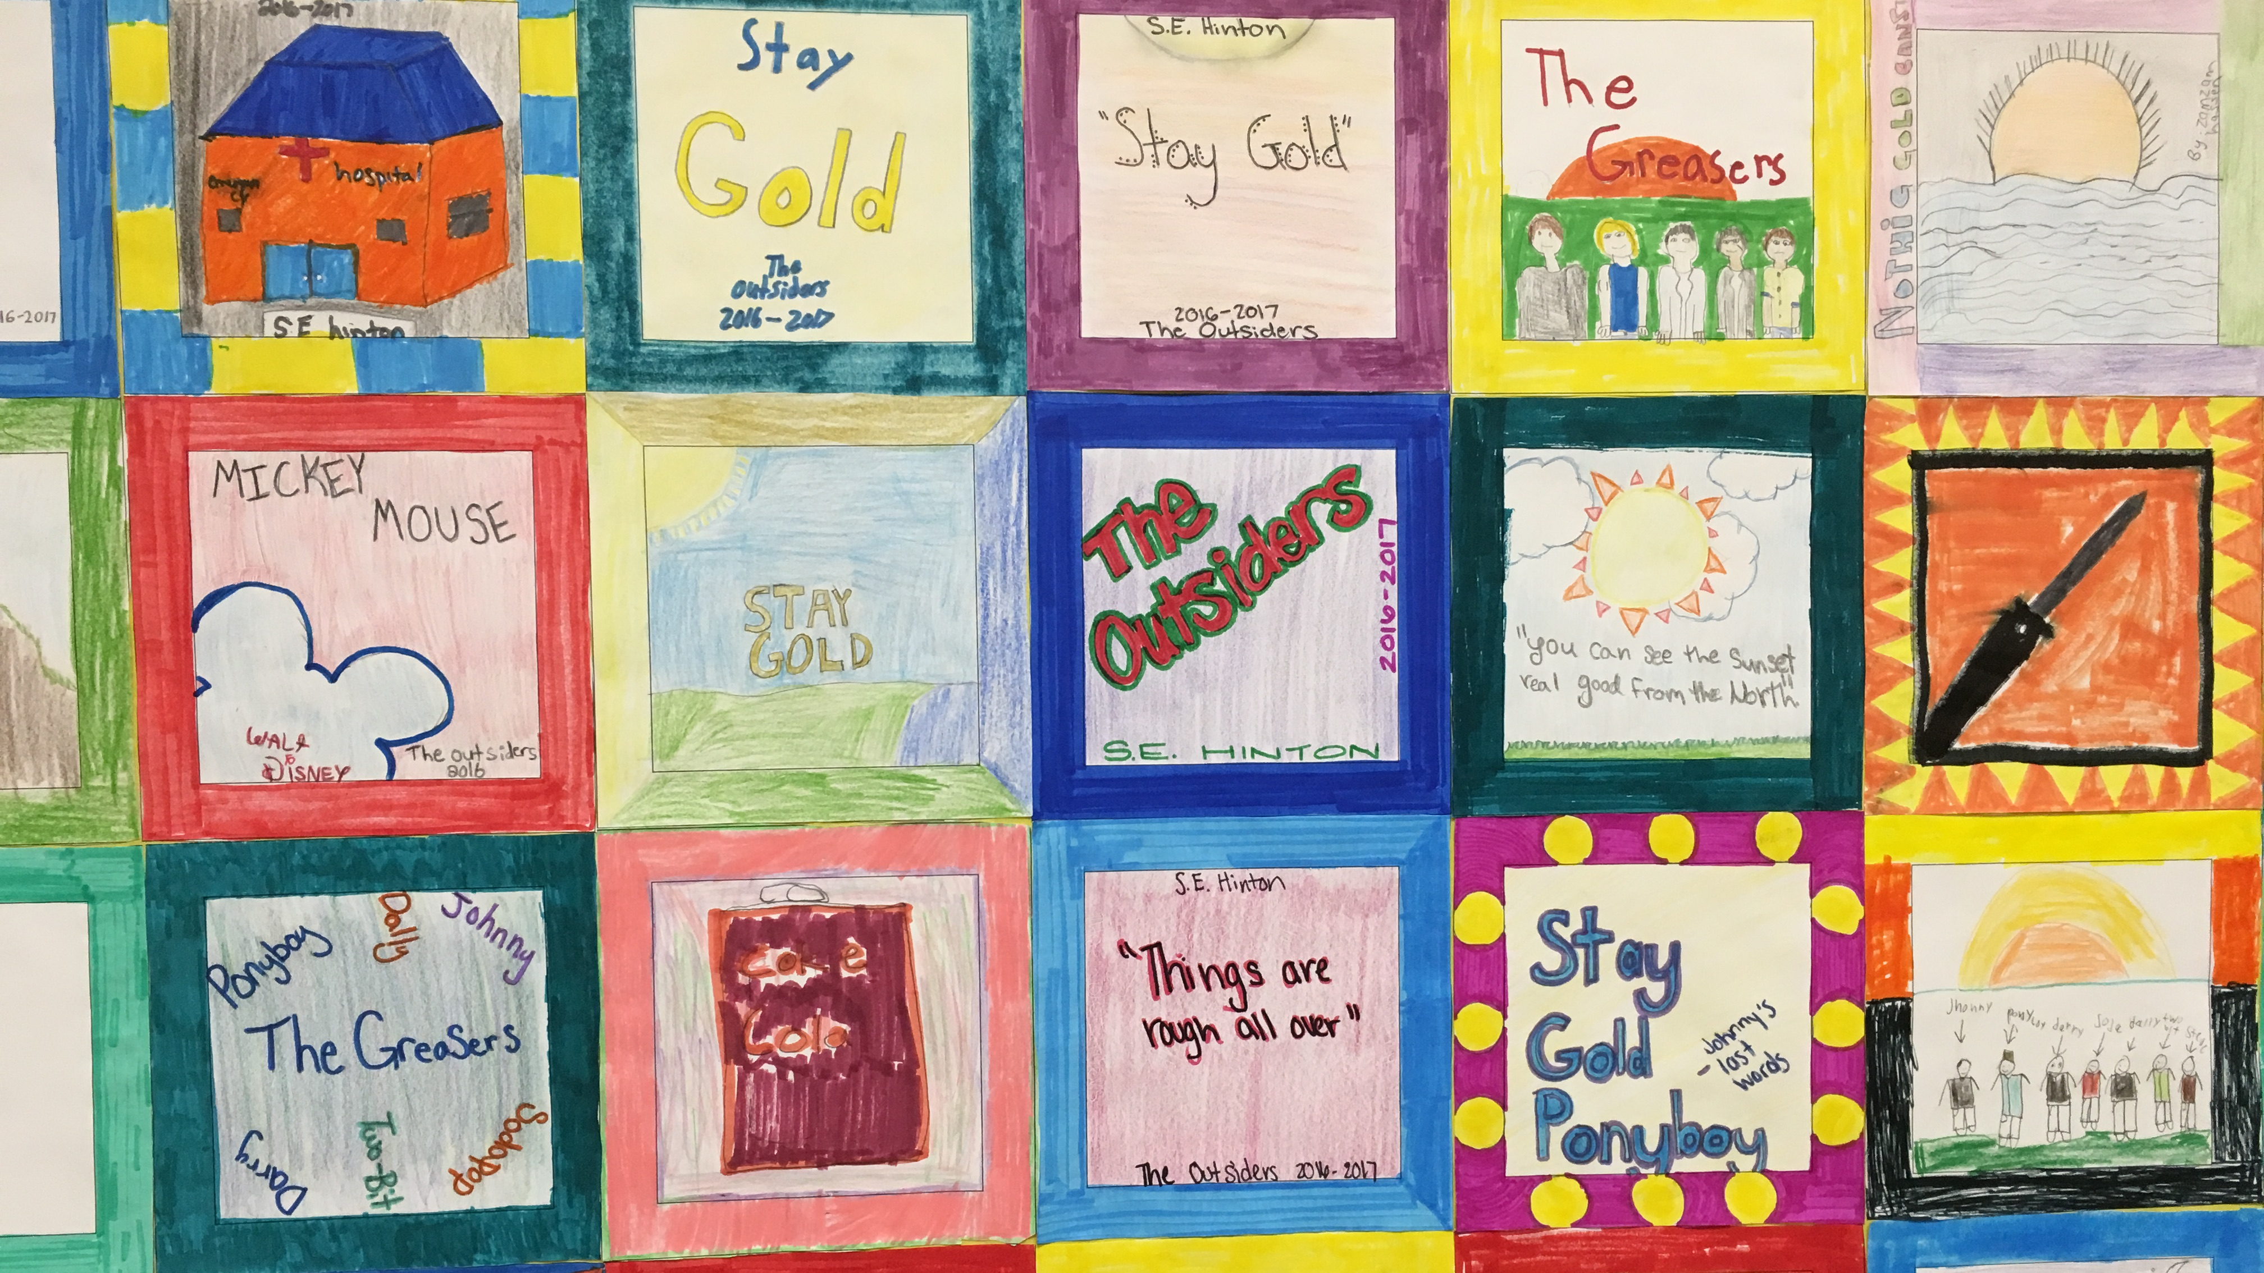
The Outsiders “quilt square” examples.

Slide 8
Day 22

Slide 9
Bell Ringer 4
Why is it important to learn how to have a formal, respectful discussion? What does a respectful discussion look like/sound like?

Slide 10
Plan for the Day
Seminar
Continue The Outsiders quilt and finish movie (if we haven’t already)
Reading Time

Slide 11
Socratic Seminar
“_______, what do you think?”
“I agree/disagree because ___________”

Slide 12
Question 1
Discuss Ponyboy’s evolving conception of the Socs. How does his opinion of the Socs at the end of the novel differ from his opinion at the beginning? Support your ideas with information from the text. ​​

Slide 13
Question 2
How is “Nothing Gold Can Stay,” the Robert Frost poem that Ponyboy recites to Johnny at the church, relevant to Ponyboy and Johnny’s story? Support your ideas with information from the text.

Slide 14
Question 3
Discuss the role of the novel’s physical setting. How does the division between the East Side and the West Side represent the conflict within the novel itself? Support your ideas with information from the text.​

Slide 15
Question 4
Compare and contrast the Curtis brothers, Darry, Sodapop, and Ponyboy. How does their relationship change over the course of the novel? Support your ideas with information from the text. ​

Slide 16
Question 5
Were Johnny and Pony right to hide out? Should they have turned themselves in immediately? Support your ideas with information from the text.

Slide 17
Outsiders Quilt and Movie!

Slide 18
Day 23

Slide 19
Bell Ringer 5

Slide 20
Plan for the Day
Introduction to narrative writing

Slide 21
Day 24

Slide 22
Bell Ringer 6

Slide 23
Plan for the Day

Slide 24
Day 25

Slide 25
Bell Ringer 7

Slide 26
Plan for the Day

