Slide 1
Unit 3
Days 11-15

Slide 2
Day 11

Slide 3
Bell Ringer
What do you like better, Frankenstein or “Flowers for Algernon?” Why?

Slide 4
Plan for the Day
Frank discussion
Logical Fallacies
Counterclaims

Slide 5
Frank Discussion
Clarification: Justine's Death

Slide 6
Logical Fallacies: What NOT to do.
Logical Fallacy: an error in logic that breaks apart your own argument.
Logical fallacies can sound intelligent, but are actually pretty stupid if you think about them.

Slide 7
Who cares???
YOU DO. If you have logical fallacies in your speech, you will lose points.
It also makes us more intelligence citizens (think about political elections, news stories, debates…)

Slide 8
Your Assignment
With a partner, define your given logical fallacy. Then create an example of each.
Be prepared to share.

Slide 9
Logical Fallacies
Slippery Slope
Hasty Generalization
Ad Hominem (“Against the Man”)
Bandwagon
Straw Man
False Dichotomy (“dye-cot-oh-me”)
Unsupported Claim

Slide 10
Review: Claims
Turn and Talk: What are claims? What is the purpose of a claim?

Slide 11
Counterclaims
Counterclaims: A claim for an opposing argument…that you then destroy with evidence and reasoning.

Slide 12
Example:
Argument: Cats are better than dogs.
Claims: Cats are cute.
Counterclaim: Some people think that dogs are cute. These people are wrong because blah blah blah.

Slide 13
Day 12

Slide 14
Bell Ringer
Who do you like more: Victor or his creature? Why?

Slide 15
Plan for the Day
IR Project
Logical Fallacies continued
Frank discussion
Outlining and Citations

Slide 16
IR Project: One Pager
The title and the author
A SHORT summary (like the blurb on the back of the book)
1 important quote from the book
A visual image (drawn or printed from a computer)
A personal statement about the book (What did it mean to you personally? What is your opinion, final thought, personal connection?)
Ask a level 3 question and answer it
FILL THE ENTIRE PIECE OF PAPER

Slide 17
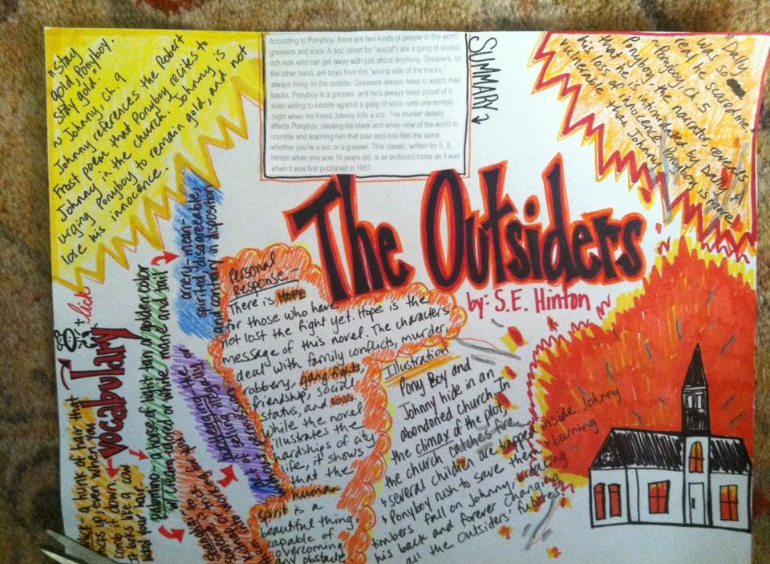

Slide 18
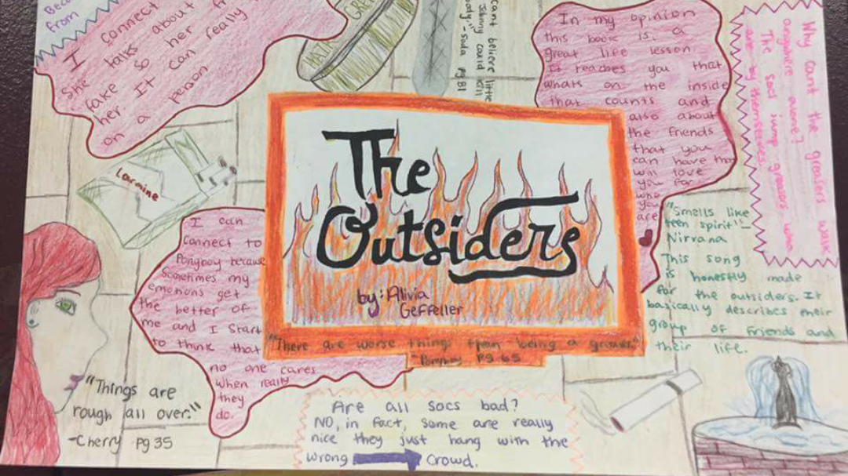

Slide 19
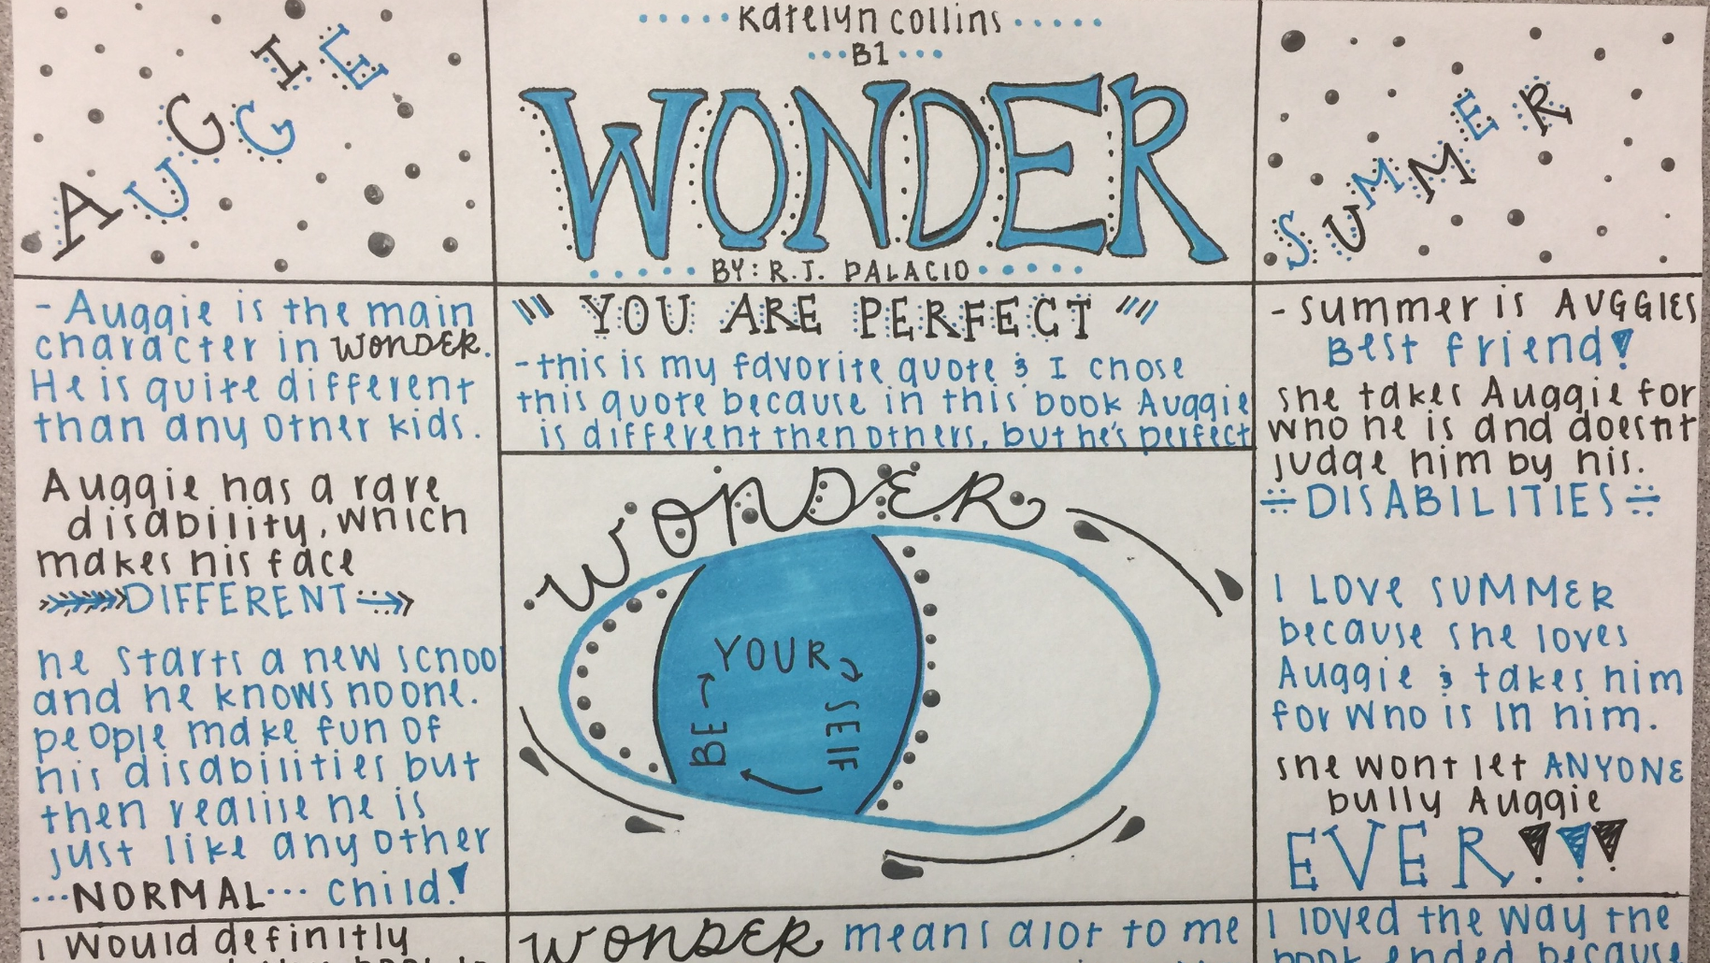

Slide 20
Logical Fallacies

Slide 21
Frank Discussion

Slide 22
Works Cited Page
For websites OTHER than ELM: www.easybib.com
For ELM: Cite button

Slide 23
Outlining: Introduction
Hook (startling fact, rhetorical question, quote, tell a story, “imagine…”)
Credibility Statement
Argument
Preview of Claims
Transition

Slide 24
Outlining: Body (Claims and Counterclaim)
Topic Sentence/Claim
Evidence
Discussion of Details/Importance
Transition

Slide 25
Outlining: Conclusion
Summary of Main Points (Claims)
Restate Argument
Concluding Statement (tie back to hook or state reason we should care)

Slide 26
Example Outlines
https://studentowatonnak12mn-my.sharepoint.com/:w:/r/personal/afranklin1_student_owatonna_k12_mn_us/_layouts/15/WopiFrame.aspx?sourcedoc=%7B4D050B62-7A3C-4398-B9EE-38AC63A07EC1%7D&file=Franklin%20Speech%20Outline.docx&action=default
https://studentowatonnak12mn-my.sharepoint.com/:w:/r/personal/jspatenka4_student_owatonna_k12_mn_us/_layouts/15/WopiFrame.aspx?sourcedoc=%7B83F1A292-5DC3-4597-AB5A-2F7D243B259E%7D&file=Spatenka%20Speech%20outline.docx&action=default
https://studentowatonnak12mn-my.sharepoint.com/:w:/r/personal/ajensen2_student_owatonna_k12_mn_us/_layouts/15/WopiFrame.aspx?sourcedoc=%7BB76729F4-134D-40B5-9E13-B7BDC2DBDD40%7D&file=A.%20Jensen%20Outline.docx&action=default

Slide 27
Work Time!
Outline due Thursday if you want full points and feedback (which you do)
Works Cited (typed and shared with me)
  LastName Speech Works Cited
  MLA heading
One Pager and Journal 4

Slide 28
Day 13

Slide 29
Bell Ringer
What is one thing you are looking forward to over break? (This does not have to be 3-5 sentences).
When you are done, get to work! Your to-do list is on the board!

Slide 30


Slide 31
Plan for the Day
Frank discussion
Work Time!
  Outline
  Works Cited
  One Pager and Journal 4

Slide 32
Frank Discussion

Slide 33
Works Cited Page
For websites OTHER than ELM: www.easybib.com
For ELM: Cite button

Slide 34
Work Time
Outline
Works Cited
One Pager and Journal 4
Missing/Re-Do Work

Slide 35
Day 14

Slide 36
Bell Ringer 8
Welcome back from break!
Look back at your research notes. What is one question you have about your topic that you need to answer? (This does not need to be 3-5 sentences).
When you are done, turn in your bell ringers.

Slide 37
Plan for the Day
Test Prep.
Frank. discussion

Slide 38
Speeches???????????
I want to wrap up Frankenstein before testing starts. After testing we will jump back into speech stuff. You will have at least one day to prepare your speech, but for the most part, you are done!
To Do (After Testing)
  -Revise your outlines based on my feedback
  -Create a Works Cited page

Slide 39
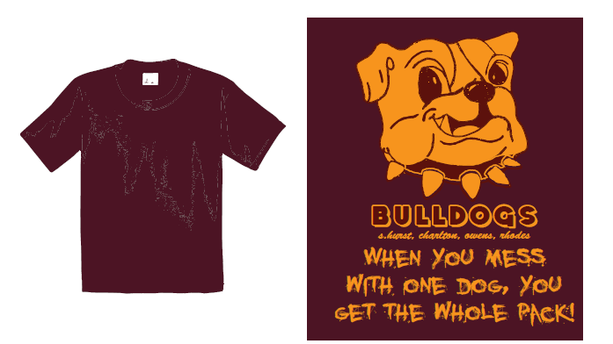

Slide 40
MCA Testing Information
A Day Testing Dates:
  Friday, April 6th
  Tuesday, April 10th
  Thursday, April 12th
B Day Testing Dates:
  Monday, April 9th
  Wednesday, April 11th
  Friday, April 13th
Bring a book!
Don’t bring your phone!
3A: We will have D lunch during testing.

Slide 41
The Score and Your Future
This test score is the first thing your teachers next year will see about you. Make a good first impression!
You may also be registered for classes based on your MCA score. (Think about all the awesome electives you get to take this year!)

Slide 42
“But testing is stupid and I hate it!”
The government (Dr. Strauss and Dr. Nemur) are testing your intelligence. You have the opportunity to show off.
Think about the stereotypes of teenagers.
Remember, this test does not define you, but it does help you learn more about yourself…and you can rub it in the face of the people that think all teenagers do and care about is Snapchat and Instagram.

Slide 43
Testing Strategies
Thinking and Asking Questions
Activating Schema
Using Context Clues and Inferences
Rereading the Passage
Understanding the Test Structure
  Test Genre
Finding and Using Directions
Eliminating Answers

Slide 44
Thinking and Answering Questions
Think about Costa’s levels of questioning. Asking and answering questions helps you understand the passage.

Slide 45
Activating Schema
What past experiences can you get information from?
What have we learned this year (or in other English classes) that could help you answer the question?
What is the author’s purpose?
  P:
  I:
  E:

Slide 46
Using Context Clues
CONTEXT CLUES are bits of information from the text that, when combined with prior knowledge, allow you to decide the meaning of unknown words in the passage you are reading.
These bits of information (words and phrases) are built into the sentences around the difficult word. By becoming more aware of the words around the difficult word, you can make an educated guess about the meaning of that word.

Slide 47
Using Context Clues
Examples:
  There are many theories, or ideas, about what made the Ice Ages happen. In this sentence the word “ideas” tells us that theories are different thoughts people have about something.
  Mary admonished her students and they knew they were in hot water for their actions. In this sentence the words “in hot water” tell us that admonished means cautioned or scolded.
  Joe was reluctant to take the job of captain of the team. He was afraid that the time it would take would hurt his grades. On the other hand, Billy was eager for the chance to be the team captain. In this sentence the words “on the other hand” and “eager” tell us that Billy feels the opposite of Joe, therefore, reluctant means uncertain or cautious.

Slide 48
Using Inferences
An INFERENCE is an educated guess about an unstated idea in the passage.
You have to make inferences by:
  Drawing Conclusions
  Forming Generalizations
  Making Predictions
Inferences are like context clues, but BIGGER.

Slide 49
Using Inferences
Inferring is as simple as:
A + B = C
Schema + Text/Illustrations = Inference
I say… + It says… = And so…

Slide 50
Rereading the Passage
First, read all directions that go along with the passage.
Second, preview the test questions.
Third, read the passage.
Fourth, work on answering the questions.
  Go back and REREAD any part of the passage that didn’t make sense to you.
  Go back and REREAD if you are unsure of an answer, you will usually find it in the passage.

Slide 51
Understanding the Test Structure
Think of standardized tests as a genre, a specific form of writing that you need to learn how to read.
Look at the following sample test. What do you see? How is this test different than a novel or a newspaper article?

Slide 52
Read this selection. Then answer the questions that follow it.
Directions
An Island Vacation
Title Bolded
Brianna Thurman spent part of her summer with her uncle’s family on Matinicus Island, Maine. Brianna’s mother suggested that she write in a journal to remember her experiences. Here is part of Brianna's journal.
Italicized
Information
1
June 12—I can’t believe Mom is making me spend a month at some place I’ve never heard of, out in the middle of nowhere. And I have to stay with a cousin I’ve never met. Just because I’m 10 doesn’t mean I can’t stay home by myself while Mom is at work. This is going to be the worst summer! Why couldn’t I have stayed in Dallas?
I have been on the ferry to the island
for an hour, with another hour to go. The
swaying of the ferry is making me
nauseated. I hope I don’t throw up.
June 15—It’s been three days, and I’ve
walked over every inch of this island. It’s
only two miles long and one mile wide.
I can walk around the whole island
in an hour.
Dates
2
Numbered
Paragraphs
Picture
3
Underlined Word

Slide 53
Finding and Using Directions
At the beginning of the test LISTEN and FOLLOW along with the directions. If you have any questions make sure to ask.
At the beginning of each passage READ the directions carefully. Make sure to follow the directions as they are written.

Slide 54
Eliminating Answers
If you do not know an answer cross out the one you know is incorrect.
Go back and REREAD the passage to find any more clues that may help you.
Use the process of elimination to chose the best possible answer, even if you don’t know if it’s correct or not.
NEVER leave an answer blank!

Slide 55
Testing Format
https://bit.ly/1RYCBLk

Slide 56
Practice Test
Using the link below, take the practice test. In about 20 minutes, I will tell you to switch to speech work.
https://bit.ly/1RYCBLk

Slide 57
Day 15

Slide 58
Bell Ringer 1
What is one fun/relaxing thing you are going to do after testing is over? (This does not have to be 3-5 sentences).

Slide 59
Plan for the Day
Continue Test Prep.

Slide 60
IMC/Learning Stairs
IMC: Get a book that you can read after you are done testing. You may keep it in the classroom as long as you put a sticky note with your name on it.
Learning Stairs: Read your book or work on missing assignments. I will pass out grade reports before we leave.

Slide 61
‘Twas the Night Before Testing
Go to bed on time.
Solve family or friend problems before the testing date so you don’t worry over them.
Talk to your parents/guardians about any concerns that you might have about the test.

Slide 62
The Morning of Testing
Start your day as you always do.
Eat a good breakfast.
Bring gum and/or mints to keep yourself alert during the test.
Think of what you will do to relax after you get home from school.
Think Positive!

Slide 63
Multiple Choice Questions
If you do not understand the directions, ask for help.
Read the passage slowly and carefully, THINK and ask yourself QUESTIONS as you read.
Read the question and all answer choices before marking anything.

Slide 64
Multiple Choice Questions
Do not change your answers unless you are very uncertain about your first answer choice.
Answer every question. Make the most intelligent and educated guess you can.

Slide 65
Pace Yourself
Don’t spend too much time on any one question. Do your best and then move on.
Remember, you cannot go back and change your answers once you have submitted them.

Slide 66
Reminders…
You CANNOT bring your own calculator or paper to the math test. You are allowed to use the embedded calculator on the test; it may not appear for all questions.
Any scratch paper used during the test MUST have your first and last name on it AND be turned in a the end of the testing block.
Headphones/Earbuds: Math - You can listen to each questions being read to you AND it will help cancel out noise. Reading – You can have them on but use them only for noise cancelling purposes.
You may NOT bring your cell phone or smart watch. Keep it in your locker or your HC teacher’s desk!

Slide 67
Frankenstein Discussion
Is the Creature human?

Slide 68
Review Videos
18 min.
Parts of Speech: https://www.youtube.com/watch?v=koZFca8AkT0&list=PL00F47D6224C0F789
Prefixes/Suffixes: https://www.youtube.com/watch?v=mRdMYuNeAng&list=RDlmNl7Mt48H8&index=2
Main Idea: https://www.youtube.com/watch?v=2cB2SOv42uQ
Figurative Language: https://www.youtube.com/watch?v=OPjAiUbdl14
Story Elements: https://www.youtube.com/watch?v=c6I24S72Jps

