Slide 1
MCA Testing

Slide 2
MCA Testing

Slide 3
MCA Testing

Slide 4
Day 19

Slide 5
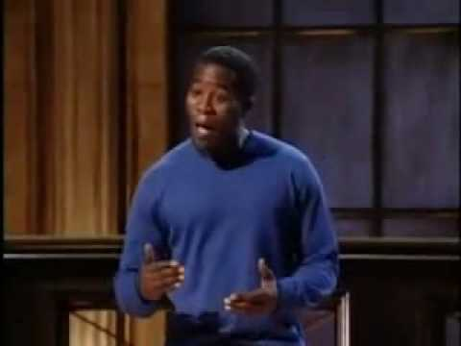
Bell Ringer 1
What was the most memorable part of the performance?
What was most effective about the presentation?
What techniques did the performer use for emphasis?

Slide 6
Plan for the Day
"FFA" Movie
Outline Revisions
Speeches start TOMORROW!

Slide 7
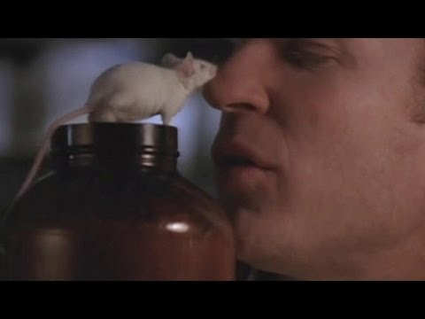
"FFA" Movie
Notes:
Skip (1:14-1:17:30)

Slide 8
Day 20

Slide 9
Bell Ringer 2
Brainstorm a list of skills that a "good" presenter has.

Slide 10
Plan for the Day
Verbal Citations
Speech Skills
Outline Revision and Work Time

Slide 11
Rubric
EU9: Strength of Arguments
EU12: Organization
EU20: Presentation Skills
Change "Audience Appropriateness" NO VISUALS REQUIRED
Note: 2-5 minutes

Slide 12
Verbal Citations
For each piece of evidence you have, you need to tell your audience where you got your information.
That means that you need to say…
Author’s name
Article title
This HAS to be said before you give the information, otherwise it is technically plagiarism.

Slide 13
Verbal Citation Sentence Stems
According to __________’s article __________….
_______ writes in his/her/their article _________…
A study reported in the article ________ by _______ states/concluded…
In the article ________, ________ states/writes/argues/claims/observes...

Slide 15
Speech Skills
Volume: how loud or soft the speaker’s voice is
Pitch: how high or low the speaker’s voice is
Rate: the speed of the speaker’s speech
Pauses
Vocal Variety: changing how you speak throughout the speech
Body Language: how the speaker is standing/moving

Slide 16
Outline Revision: Big Things
Credibility Statement: Why should your audience trust you?
Evidence: Direct quote from the article WITH a citation. (AuthorLastName)
Counter-claim: Don't forget to tear apart the opposing argument!

Slide 17
Work Time
Revise your outline
Create a clean copy for me to grade
Works Cited/Annotated Bibliography
Create your notecards
Only put words and phrases that will help you remember your speech!
Practice on your own. Time yourself!
Practice with a partner. Get/give feedback.

Slide 18
"FFA" Movie
Notes:
Skip (1:14-1:17:30)

