Slide 1
Unit 3 Days 21-25

Slide 2
Day 21

Slide 3
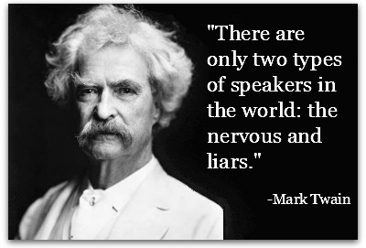
Bell Ringer 3
What is the absolute WORST thing that could happen during your speech?

Slide 4
Plan for the Day
Speeches!

Slide 5
Speech Protocol
I have a randomized list of names. You will present in that order.
If you are not ready, you need to say “I’m not ready.” You will then be moved to the top of the list for the next speech day and will receive a deduction of points.
If you are talking during speeches, you will be docked points.
Timer: I will stop you at 5 minutes and 30 seconds
Audience Participation Graphic Organizer

Slide 6
Day 22

Slide 7
Bell Ringer 4
Define the following terms/concepts in your own words to the best of your ability:
-Adolf Hitler
-The Holocaust
-Genocide

Slide 8
Plan for the Day
Finish speeches
Intro to Unit 4

Slide 9
Finish Speeches

