Slide 1
Unit 3 Days 6-10

Slide 2
Day 6

Slide 3
Bell Ringer
Why does Mary Shelley start her story with the letters? Make connections from “The Letters” to the ideas we discussed last class. Use the notes you took during the presentations to help you.
Please have your Frank packet and your journal out and ready for me to initial.

Slide 4
Plan for the Day
Frankenstein: “The Letters” and Chapter 1 Discussion
Homework: Shelley (26-50)
Finish “FFA”

Slide 5
Frank Discussion

Slide 6
Finish “FFA”

Slide 7
“FFA” Wrap Up
Page 64 #1-5
Timeline

Slide 8
Looking back at “Would You Rather”
We are going to look back at some of the “Would You Rather” questions from the start of the unit.
After each question, we will talk about what Charlie would pick.
Then we will make connections to the story. Why did I ask each question?

Slide 9
Would you rather...
Be smart?
Be funny?

Slide 10
Would you rather...
Be smart, but know that people hate you?
Be dumb, but not know that people hate you?

Slide 11
Would you rather...
Be physically fit/strong?
Be smart?

Slide 12
Would you rather...
Be good looking?
Be smart?

Slide 13
Would you rather...
Be smart, but know that people hate you?
Be dumb, but not know that people hate you?

Slide 14
Would you rather...
Know everything for 5 years, but then you die?
Have a below average intelligence, and live for a normal amount?

Slide 15
Day 7

Slide 16
Bell Ringer
At the end of “Flowers for Algernon,” Charlie writes, “Its easy to make frends if you let pepul laff at you.”
Do you agree or disagree with Charlie’s opinion? Explain your answer.

Slide 17
Plan for the Day
Frank discussion
Introduction to Argument, Claims, and Evidence

Slide 18
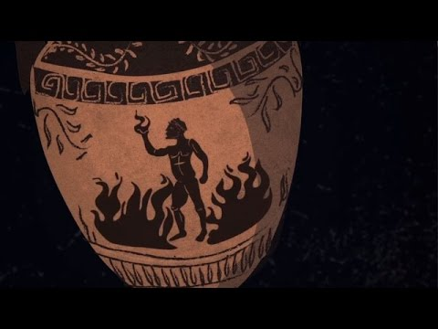
Frank Discussion

Slide 19
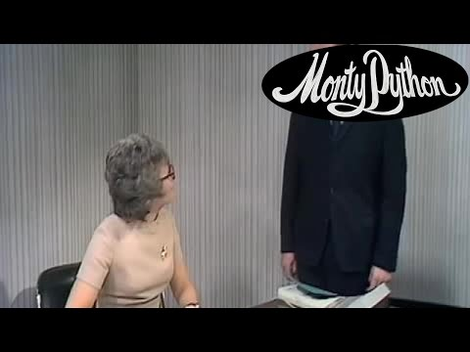
Argument, Claims, and Evidence

Slide 20
Argument
Argument: an author's opinion (AKA thesis statement)
Sometimes the same thing as the main idea, but not always.

Slide 21
Identifying the Argument
Look at the title of the text.
Read the introduction paragraph.
Read the conclusion paragraph.
Most authors will summarize their opinion in each of these places.

Slide 22
Claims
Claim: statements in support of an author's argument; answers the question "Why do you believe your opinion is true?"

Slide 23
What's the argument? What's the claim?
Justin Timberlake is the best singer because he can sing and he can dance.

Slide 24
What's the argument? What's the claim?
Justin Timberlake is the best singer because he can sing and he can dance.
Argument
Claims

Slide 25
Evidence
Evidence: anything that supports and author's claim

Slide 26
ACE Tree (on the back board)

Slide 27
Identifying the ACE
Eating candy every day is bad for your health because it causes weight gain and an increased risk for diabetes. According to Dr. Mcstuffins, if someone were to eat a Snickers bar for breakfast seven days a week, they would weigh roughly 850 pounds after one year. She also stated that if that same person continued this diet, they would be 6 times as likely to become diabetic by the age of 30.

Slide 28
Note: I made all this information up
Eating candy every day is bad for your health because it causes weight gain and an increased risk for diabetes. According to Dr. Mcstuffins, if someone were to eat a Snickers bar for breakfast seven days a week, they would weigh roughly 850 pounds after one year. She also stated that if that same person continued this diet, they would be 6 times as likely to become diabetic by the age of 30.

Slide 29
Frank Work Time

Slide 30
Day 8

Slide 31
Bell Ringer
Identify the argument and claims in the following passage:
Cats are excellent pets. Cats are low maintenance and do not require around-the-clock supervision. Cats are also soft and warm which makes them very nice to pet.

Slide 32
Plan for the Day
Frank discussion
Go over green packet
Mini seminar (next class)
Evidence continued

Slide 33
Evidence
Statistics
Expert Testimonies
Anecdotes/Examples
Analogies

Slide 34
Statistics: numbers
“4 out of 5 dentists recommend chewing sugarless gum”
“99% of students think Ms. Charlton’s class is lit”
“The population of Owatonna is 25,546 people”

Slide 35
Expert Testimonies:
Quotes from people who know more than you (and probably your reader)
Usually comes with an explanation of why that person is an expert.
“Dr. Thermopolis, a pediatrician at one of the nation’s highest ranking hospitals, says that ‘candy is good for you.’”

Slide 36
Anecdotes/Examples
Evidence based on observations
“When walking down the halls at OMS, I noticed that the majority of students were on their cell phones. This tells me that cell phones are an important part of their education”

Slide 37
Types of Examples
Personal story (could be yours or someone else's)
Distracted driving can harm innocent bystanders.
Historical examples
Power can corrupt leaders.
Current event
School shootings are becoming more common.
Hypothetical situation ("imagine if...")
Imagine if you were about to have a baby...in an incubator.
Cultural Connection
Some marriages can continue after an affair.

Slide 38
Analogies
Using metaphor to explain something
https://vimeo.com/27060669

Slide 39
Day 9

Slide 40
Bell Ringer
Identify the evidence in the following passage:
All whales belong in the ocean. Aquariums like Sea World have abused animals in the past as seen in the movie Black Fish. According to zoologist Phil Plom, “87% of whales would be happier in the wild.”

Slide 41
Plan for the Day
Frank discussion
Mini seminar
Manipulating Your Audience: Ethos, Pathos, Logos

Slide 42
Frank Discussion

Slide 43
Day 10

Slide 44
Bell Ringer
Identify the tone of the following passage. Then justify your answer in 3-5 sentences:​
“Mr. Jones, since you obviously appear to know everything, would you like to come up here and teach this class for me?”​
Sarcastic​
Critical​
Disrespectful

Slide 45
Plan for the Day
Breaking News!
Frank discussion
Manipulating Your Audience: Ethos, Pathos, Logos

Slide 46
BREAKING NEWS!
We are behind schedule. No one is surprised.
JK, I am…I shouldn’t be, but I am.

Slide 47
Frank Discussion

Slide 48
Ad Sort
Cut the ads apart (you should end up with 7 different ads).
Sort the ads. There is no correct answer!
Take notes in your notebook on how you grouped the ads.

Slide 49
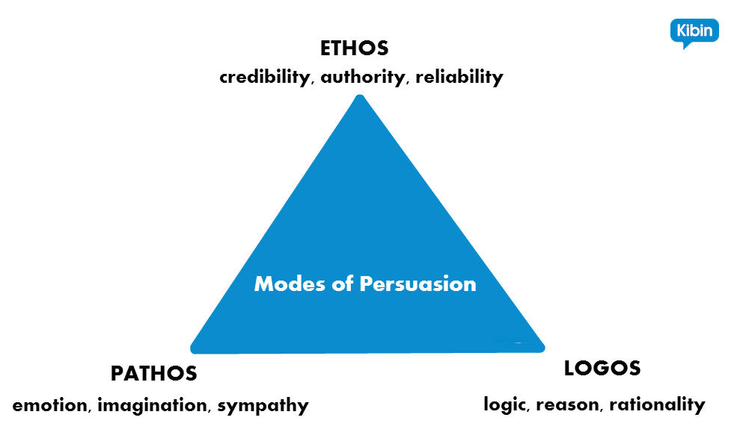

Slide 50
Ethos
The credibility of the speaker/writer.
Speaker/Writer-Audience/Reader trust

Slide 51
Pathos
An appeal to emotion.
Using an audience’s emotions makes them feel personally connected to the issue.
Be careful with this one!

Slide 52
Logos
The use of logic, reasoning, evidence, and facts to support an argument.

Slide 53
Turn and Talk: What would happen if you just had ONE of these? How many do you think a “good” argument should have?

Slide 54
Re-Sort the Ads

Slide 55
Examples of Ethos, Pathos, Logos in Commercials
While we watch, identify the PROMINENT technique. Some will use more than one, but each one has one that is used more than the others.

Slide 56
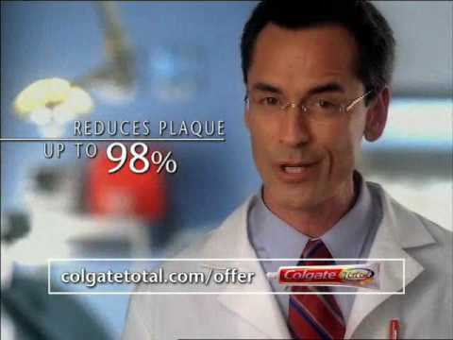

Slide 57
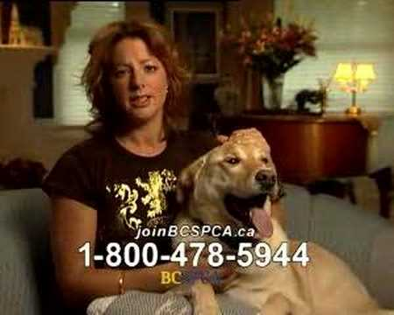

Slide 58
