Slide 1
Unit 4 Days 1-5

Slide 2
Day 1

Slide 3
Bell Ringer
What do you know about Anne Frank? Who is she? Why is she famous? What happened to her?

Slide 4
Plan for the Day
Final Speeches! (Suzy and Reid)
Intro to Unit 4

Slide 5
Unit 4
Unit Topic: The Human Spirit​
Unit Focus:​
Research paper​
Review of big ideas​
Anchor Text: “The Diary of Anne Frank” and They Poured Fire on us from the Sky

Slide 6
Essential Questions
What does it take to overcome obstacles?​
How do people cope with daily life under difficult circumstances?​
Does good always triumph over evil?​
What does it mean to be a survivor?

Slide 7
Unit 4 Pre-Work
Start a new page in your notebook and title it "Unit 4 Pre-Work."
All the work that you do over the next two class periods (other than bell ringers) should go on this page.

Slide 8
Quick Write
What are your thoughts about this poem?
What does it mean?
What is it talking about? Make as many connections to history that you can.

Slide 10
Images of the Holocaust
For each image, jot down a few thoughts. Don't overthink it. Just write down your reactions.

Slide 15
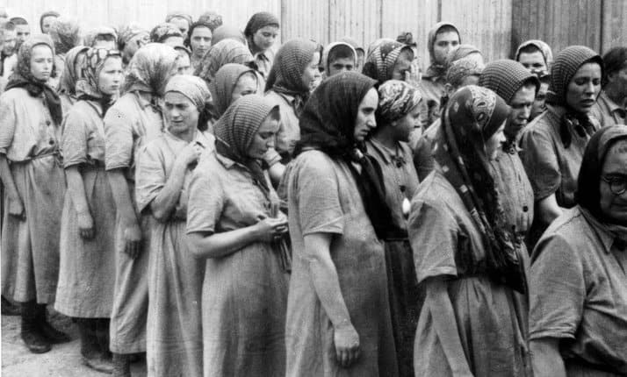

Slide 24
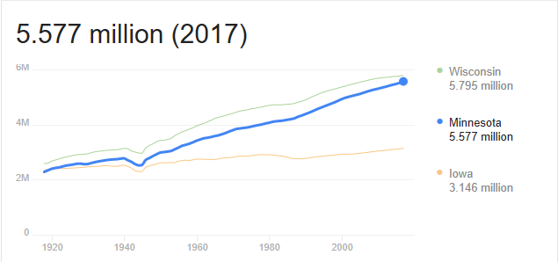

Slide 25
Selections from They Poured Fire
In the remaining minutes of class, grab a book and start exploring. Feel free to skip around. As we read Anne Frank, we are going to compare her story with the Lost Boys.

Slide 26
Day 2

Slide 27
Bell Ringer
Last class we learned a lot about the Holocaust and how Jews were treated. What are two things you remember from what we talked about?

Slide 28
Plan for the Day
Continue Unit 4 Pre-Work
Start reading DoAF?

Slide 29
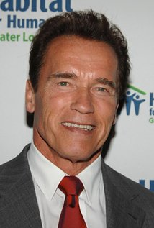
Modern Connections to the Holocaust

Slide 30
Background Research
Meet with your group. Decide who is going to read each article.
Read the article on your own. While you read, take notes on the important details on your pre-work page. Be prepared to share with your group.
Meet back with your group. Take turns sharing your information.
When you are done, turn in your pre-work.

Slide 31
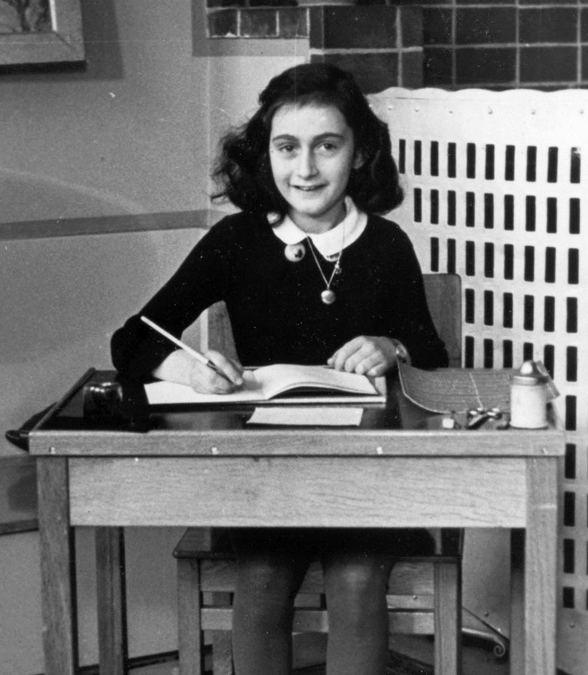
The Story of Anne Frank
http://www.annefrank.org/en/Subsites/Home/Enter-the-3D-house/#/house/20/

Slide 32
More Info on Anne Frank
Read “Background: Literature and Life” (365-366)

Slide 33
Day 3

Slide 34
Bell Ringer 8
We know what happens to Anne and her family. How does this change how we react to the story?
When you are done, put your name on your bell ringers and put them in the basket.

Slide 35
Plan for the Day
Quarter 4 IR Project
Mapping the Annex
Read Scenes 1-2
Reading Guides

Slide 36
Quarter 4 IR Project
Journals (due every other week)
You only need to complete THREE of the journals, but you do need to finish your book.
Journal 1: 8th/9th
Journal 2: 14th/15th
Journal 3: 22nd/23rd
Comic Strip: Due May 22nd/23rd

Slide 37
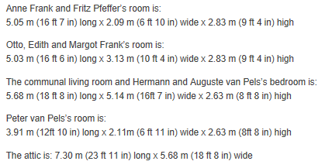
Mapping the Annex
8 people live in the annex for 2 years

Slide 39
“The Diary of Anne Frank” Scenes 1-2
We are going to read the script aloud. Everyone needs to read at LEAST twice.
It does not matter how small the role is, you still need to practice reading aloud.
Read once: 8/10 Read twice: 10/10

Slide 40
“Diary of Anne Frank” Reading Guides
Other than your IR project and your research project, this will be your only homework for the rest of the year…probably.
Take the rest of class to start the reading guides with your group.

Slide 41
Day 4

Slide 42
Bell Ringer
What do you think of the play so far? Is it what you expected it to be? Why or why not?
Happy Friday! Find your new seat.

Slide 43
Plan for the Day
Finish scene 2
DoAF Movie: Scenes 1-3
Characters

Slide 44
Movie!
While we watch, pay close attention to how the characters are represented in the film. After the movie (about 40 minutes) we are going to focus on descriptions of the characters.

Slide 45
Conflict Review
What are the types of conflict?

Slide 46
Types of Conflict

Slide 47
Identify Conflict...
Identify each type of conflict in the texts we have read this year.
"Flowers for Algernon"
The Diary of Anne Frank
The Outsiders
"After Twenty Years"
"The Circuit"
"Charles"
"The Lottery"
Frankenstein
Breaking Night

Slide 48
Characterization Review
Is the character interesting?
Does the character change?
Flat: a simple character that the reader might not know a lot about
Round: complicated characters that the reader knows a lot about
Static: a character who changes
Dynamic: a character who stays the same

Slide 49
DoAF: Character and Conflict
With your Unit 4 group, you are going to describe the main characters in the play. Each person must do an equal amount of the work.
Group Folders

Slide 50
Work Time
Reading Guide
Character and Conflict Packet
Reading/Journal 1
Missing Work

Slide 51
Day 5

Slide 52
Bell Ringer

Slide 53
Plan for the Day
DoAF Scenes 4 and 5

